Slide 1
Principles of Distributed Database Systems
M. Tamer Özsu
Patrick Valduriez

Slide 2
Parallel Database Systems
Parallel DB Architecture
Parallel Data placement
Parallel Query processing
Load balancing
Database clusters

Slide 3
The Database Problem
Large volume of data ⇒ use disk and large main memory
I/O bottleneck (or memory access bottleneck)
Speed(disk) << speed(RAM) << speed(microprocessor)
Predictions
Moore’s law: processor speed growth (with multicore): 50 % per year
DRAM capacity growth : 4 ⋅ every three years
Disk throughput : 2 ⋅ in the last ten years
Conclusion : the I/O bottleneck worsens
Notes:
Speed is less means reading and writing time is more.

Slide 4
The Solution
Origins (1980's): database machines
Hardware-oriented ⇒ bad cost-performance ⇒ failure
1990's: same solution but using standard hardware components integrated in a multiprocessor
Software-oriented
Standard essential to exploit continuing technology improvements

Slide 5
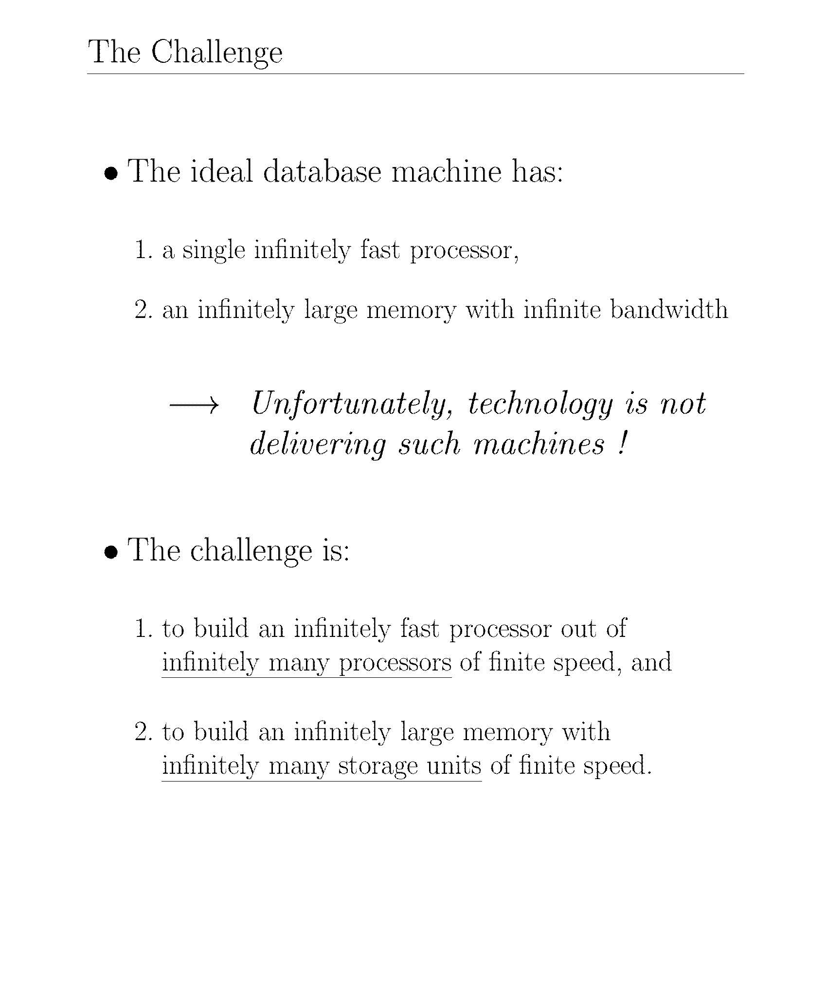
Notes:
Instead of 1 big, we can have small many processors.

Slide 6
Multiprocessor Objectives
High-performance with better cost-performance than mainframe or vector supercomputer
Use many nodes, each with good cost-performance, communicating through network
Good cost via high-volume components
Good performance via bandwidth
Trends
Microprocessor and memory (DRAM): off-the-shelf
Network (multiprocessor edge): custom
The real challenge is to parallelize applications to run with good load balancing
Notes:
Processor – means disk, memory, and storage all together (called a node).
If we have small many then we also need to connect.

Slide 7
Data Server Architecture
Client
client interface
Application
server
query parsing
data server interface
communication channel
Data
server
application server interface
database functions
database
Notes:
Previously, the servers were together but here they are separated (Application service and data server).

Slide 8
Objectives of Data Servers
Avoid the shortcomings of the traditional DBMS approach
Centralization of data and application management
General-purpose OS (not DB-oriented)
By separating the functions between
Application server (or host computer)
Data server (or database computer)

Slide 9
Data Server Approach: Assessment
Advantages
Integrated data control by the server
Increased performance by dedicated system
Can better exploit parallelism
Fits well in distributed environments
Potential problems
Communication overhead between application and data server
High-level interface
High cost with mainframe servers
Notes:
If we separate the servers we get these advantages and problems.

Slide 10
Parallel DBMS
Loose definition: a DBMS implemented on a parallel computer system including Tightly coupled multiprocessor system and/or Loosely coupled multiprocessor system
Alternative extremes
Straightforward porting of relational DBMS (the software vendor edge)
New hardware/software combination (the computer manufacturer edge)
Naturally extends to distributed databases with one server per site

Slide 11
Parallel DBMS
Tightly coupled multiprocessor system: Symmetric multiprocessing or shared-memory multiprocessing (SMP)
It contains multiple CPUs that are connected at the bus level.
These CPUs may have access to a central shared memory, or may participate in a memory hierarchy with both local and shared memory.
Chip multiprocessors, also known as multi-core computing involve more than one processor placed on a single chip and can be thought of the most extreme form of tightly coupled multiprocessing.
Notes:
CPUs can have access to a central shared memory - this is important.
Logically we have one memory (Physically we don’t care)

Slide 12
Parallel DBMS
Loosely coupled multiprocessor system
Loosely coupled multiprocessor systems (often referred to as clusters) are based on multiple standalone single or dual processor commodity computers interconnected via a high speed communication system (Gigabit Ethernet is common).
Tightly coupled systems perform better and are physically smaller than loosely coupled systems, but have historically required greater initial investments and may depreciate rapidly;
Nodes in a loosely coupled system are usually inexpensive computers and can be recycled as independent machines upon retirement from the cluster.
Loosely coupled systems have the ability to run different operating systems or OS versions on different systems.
Notes:
Logically the memory is separated (Physically also multiple memories)
Tightly couples are better but expensive.

Slide 13
Parallel DBMS - Objectives
Much better cost / performance than mainframe solution
High-performance through parallelism
High throughput with inter-operation parallelism
Low response time with intra-operation parallelism
High availability and reliability by exploiting data replication
Extensibility with the ideal goals
Linear speed-up
Linear scale-up

Slide 14
Data-based Parallelism
Inter-operation parallelism
p operations of the same query in parallel
op.3
op.1
op.2
Intra-operation parallelism
The same op in parallel
op.
op.
op.
op.
op.
R
R₁
R₂
R₃
R₄
Notes:
Op. 1 and Op. 2 can be done separately and are not related.
R relation is divided into 4 fragments - then do it in parallel

Slide 15
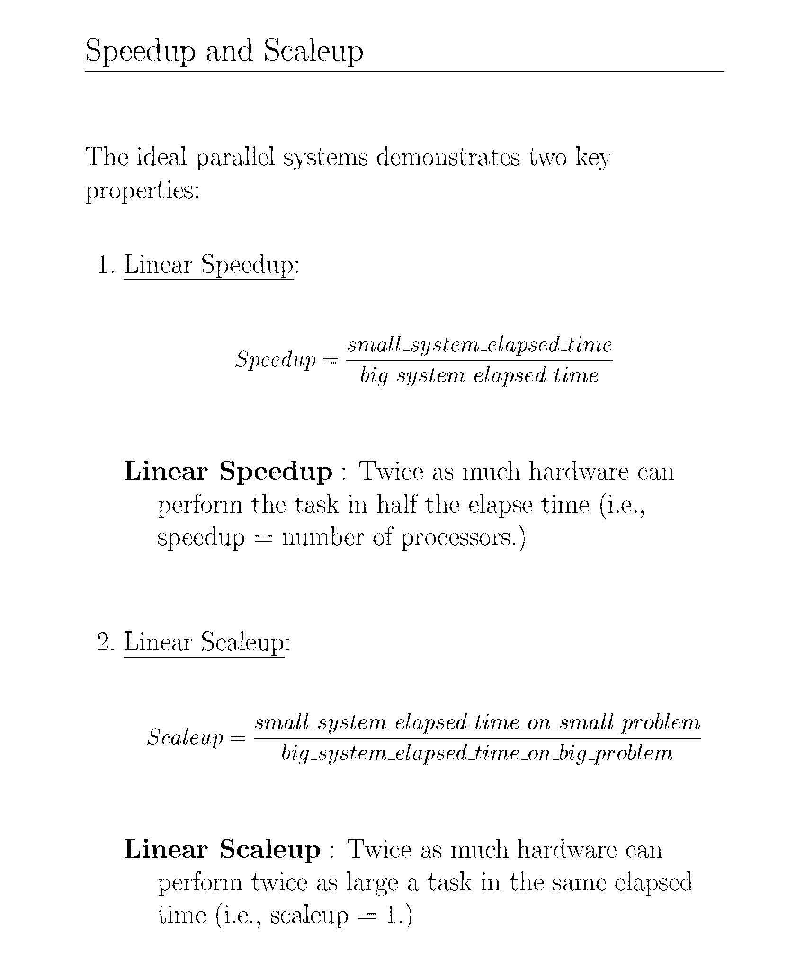

Slide 16
Parallel System Architectures
Multiprocessor architecture alternatives
Shared memory (SM)
Shared disk (SD)
Shared nothing (SN)
Hybrid architectures
Non-Uniform Memory Architecture (NUMA)
Tightly coupled
Cluster (Shared nothing + shared disk: NAS/SAN)
Loosely coupled
Notes:
Multiple SM machines are NUMA.
Multiple SD or SN is Cluster

Slide 17
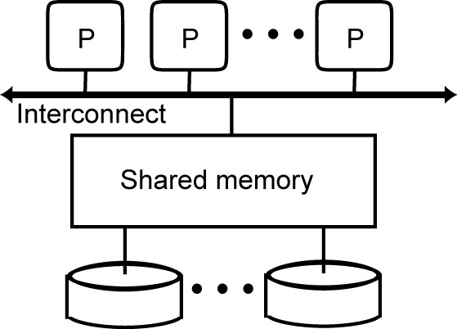
Shared-Memory
DBMS on Symmetric Multi-Processors (SMP)
Prototypes: XPRS, Volcano, DBS3
+ Simplicity, load balancing, fast communication
- Network cost, low extensibility
Notes:
P: Processor

Slide 18
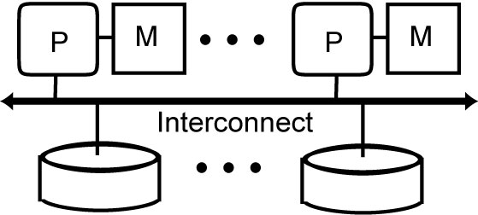
Shared-Disk
Origins : DEC's VAXcluster, IBM's IMS/VS Data Sharing
Used first by Oracle with its Distributed Lock Manager
Now used by most DBMS vendors
+ network cost, extensibility, migration from uniprocessor
- complexity, potential performance problem for cache coherency
(Cache coherence is the consistency of shared resource data that ends up
stored in multiple local caches)

Slide 19
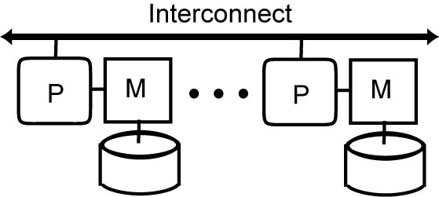
Shared-Nothing
Used by Teradata, IBM, Sybase, Microsoft for OLAP
Prototypes: Gamma, Bubba, Grace, Prisma, EDS
+ Extensibility, availability
- Complexity, difficult load balancing

Slide 20
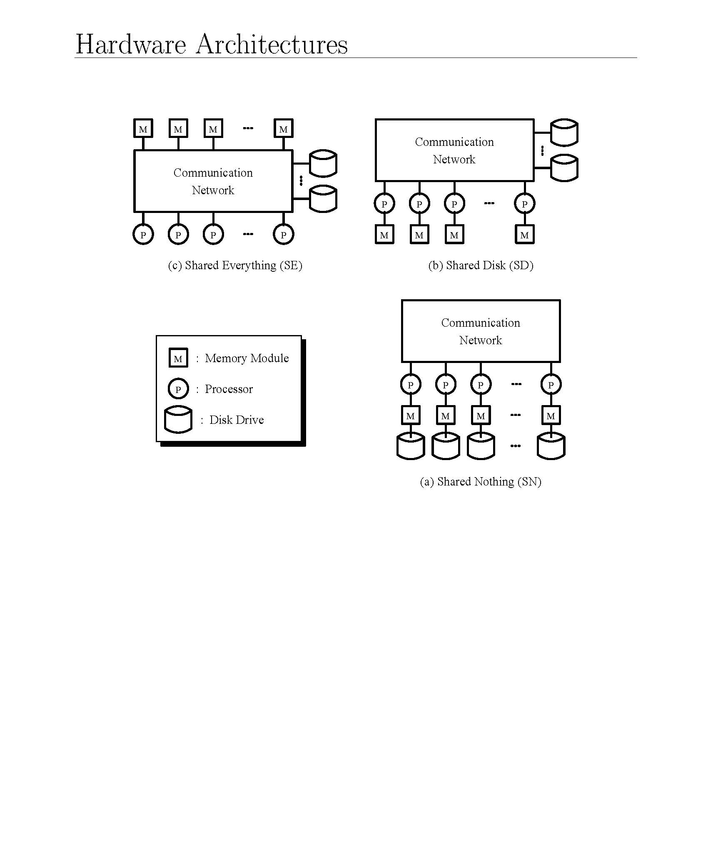
Notes:
Shared everything is nothing but shared memory.

Slide 21
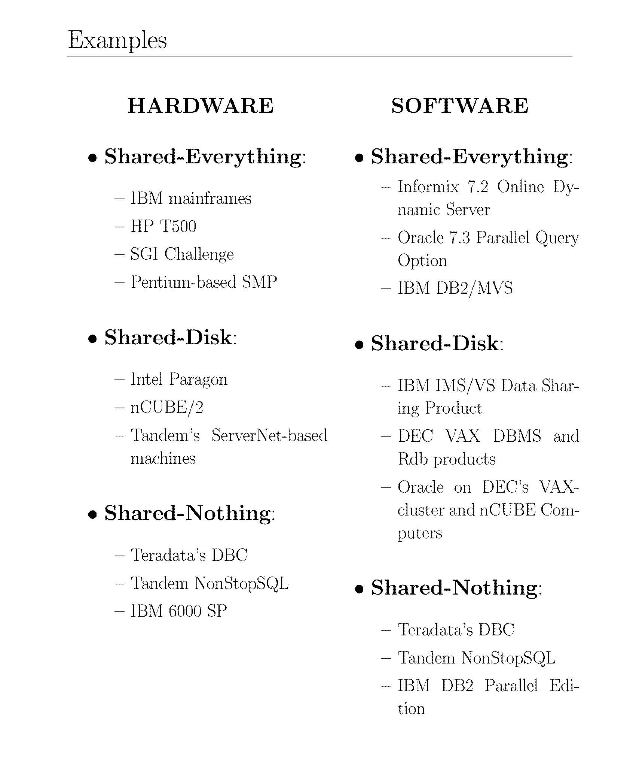

Slide 22
Hybrid Architectures
Various possible combinations of the three basic architectures are possible to obtain different trade-offs between cost, performance, extensibility, availability, etc.
Hybrid architectures try to obtain the advantages of different architectures:
efficiency and simplicity of shared-memory (NUMA)
extensibility and cost of either shared disk or shared nothing (Cluster)
2 main kinds: NUMA and Cluster
Notes:
Non-uniformed memory architecture.

Slide 23
NUMA (Non-Uniform Memory Architecture)
A method of configuring a cluster of microprocessor in a multiprocessing system so that they can share memory locally, improving performance and the ability of the system to be expanded.
Shared-Memory
Mixes two different aspects : addressing and physical memory
Addressing: single address space vs multiple address spaces
Physical memory: central vs distributed
NUMA = single address space on distributed physical memory
Eases application portability, Extensibility
The most successful NUMA is Cache Coherent NUMA (CC-NUMA)
Notes:
Multiple SM

Slide 24
CC-NUMA
Principle
Main memory is physically distributed among the nodes as with shared-nothing or shared-disk.
Any processor has access to all other processors’ memories (shared memory)
Similar to shared-disk, different processors can access the same data in a conflicting update mode, so global cache consistency protocols are needed.
In order to make remote memory access efficient, the only viable solution is to have cache consistency done in hardware through a special consistent cache interconnect.
Because shared-memory and cache consistency are supported by hardware, remote memory access is very efficient, only several times (typically between 2 and 3 times) the cost of local access.

Slide 25
Cluster
A cluster is a set of independent server nodes interconnected to share resources and form a single system.
The shared resources, called clustered resources, can be hardware such as disk or software such as data management services.
The server nodes are made of off-the-shelf components ranging from simple PC components to more powerful SMP (Symmetric Multi-Processors) .
Using many off-the-shelf components is essential to obtain the best cost/performance ratio while exploiting continuing progress in hardware components.
In its cheapest form, the interconnection can be a local network. However, there are now fast standard interconnecttions for clusters (e.g., Myrinet and Infiniband) that provide high bandwidth (Gigabits/sec) with low latency for message traffic.
Notes:
Multiple SD or SN

Slide 26
Cluster
Its architecture can be either shared nothing or shared-disk.
Shared-nothing clusters have been widely used because they can provide the best cost/performance ratio and scale up to very large configurations (thousands of nodes).
However, because each disk is directly connected to a computer via a bus, adding or replacing cluster nodes requires disk and data reorganization.
Shared-disk avoids such reorganization but requires disks to be globally accessible by the cluster nodes.

Slide 27
SN cluster vs SD cluster
SN cluster can yield best cost/performance and extensibility
But adding or replacing cluster nodes requires disk and data reorganization
SD cluster avoids such reorganization but requires disks to be globally accessible by the cluster nodes
Network-attached storage (NAS)
distributed file system protocol such as NFS (Network File System), relatively slow and not appropriate for database management
Storage-area network (SAN)
Block-based protocol thus making it easier to manage cache consistency, efficient, but costlier
Notes:
SN is less expensive than SD.
Replacing cost can be high.

Slide 28
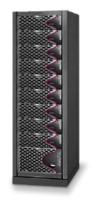
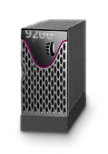
NAS vs SAN architecture
Clients
LAN
LAN
Database Servers
Win2k
Linux
Unix
Generic
Generic
Fibre Channel SAN
Application
Servers
Block Storage Devices
NAS Appliances
or
NAS Head Ends
Storage Area Network (SAN)
Notes:
NAS is a storage server.
Left figure we have only one network whereas right figure we have 2 networks.
SAN is better. The client sends small queries and the server to storage there is a lot of data flow.
Left figure: SN, Right figure: SD

Slide 29
Discussion
For a small configuration (e.g., 8 processors), SM can provide the highest performance because of better load balancing
Some years ago, SN was the only choice for high-end systems. But SAN makes SD a viable alternative with the main advantage of simplicity (for transaction management)
SD is now the preferred architecture for OLTP
But for OLAP (Online Analytical Processing) databases that are typically very large and mostly read-only, SN is used
Hybrid architectures, such as NUMA and cluster, can combine the efficiency and simplicity of SM and the extensibility and cost of either SD or SN

Slide 30
Barriers to Parallelism
Startup
The time needed to start a parallel operation may dominate the actual computation time
Interference
When accessing shared resources, each new process slows down the others (hot spot problem)
Skew
The response time of a set of parallel processes is the time of the slowest one
Parallel data management techniques intend to overcome these barriers
Notes:
Skew: If R1 is bigger than R2, R3 and R4, the we need to wait for R1 to complete.

Slide 31
Parallel Database Systems
Parallel DB Architecture
Parallel Data placement
Parallel Query processing
Load balancing
Database clusters

Slide 32
Parallel DBMS Techniques
Data placement (Partitioning)
Physical placement of the DB onto multiple nodes
Static vs. Dynamic
Parallel data processing
Select is easy
Join (and all other non-select operations) is more difficult
Parallel query optimization
Choice of the best parallel execution plans
Automatic parallelization of the queries and load balancing
Transaction management
Similar to distributed transaction management

Slide 33
Combining Fragmentation & Allocation
Partition the data to dictate where it is located
Workload-agnostic techniques
Round-robin partitioning
Hash partitioning
Range partitioning
Workload-aware techniques
Graph-based approach
Notes:
We have a partition/fragment, how do we partition to different ranges? (That is the main idea)

Slide 34
Data Partitioning
Each relation is divided in n partitions (subrelations), where n is a function of relation size and access frequency
Implementation
Round-robin
Maps i-th element to node i mod n
Simple but only exact-match queries
Interval (B-tree index)
Supports range queries but large index
Hash function
Only exact-match queries but small index

Slide 35
Partitioning Schemes
•••
•••
•••
•••
•••
Round-Robin
Hashing
•••
a-g
h-m
•••
u-z
Interval
Notes:
We are doing all these to speed up.

Slide 36
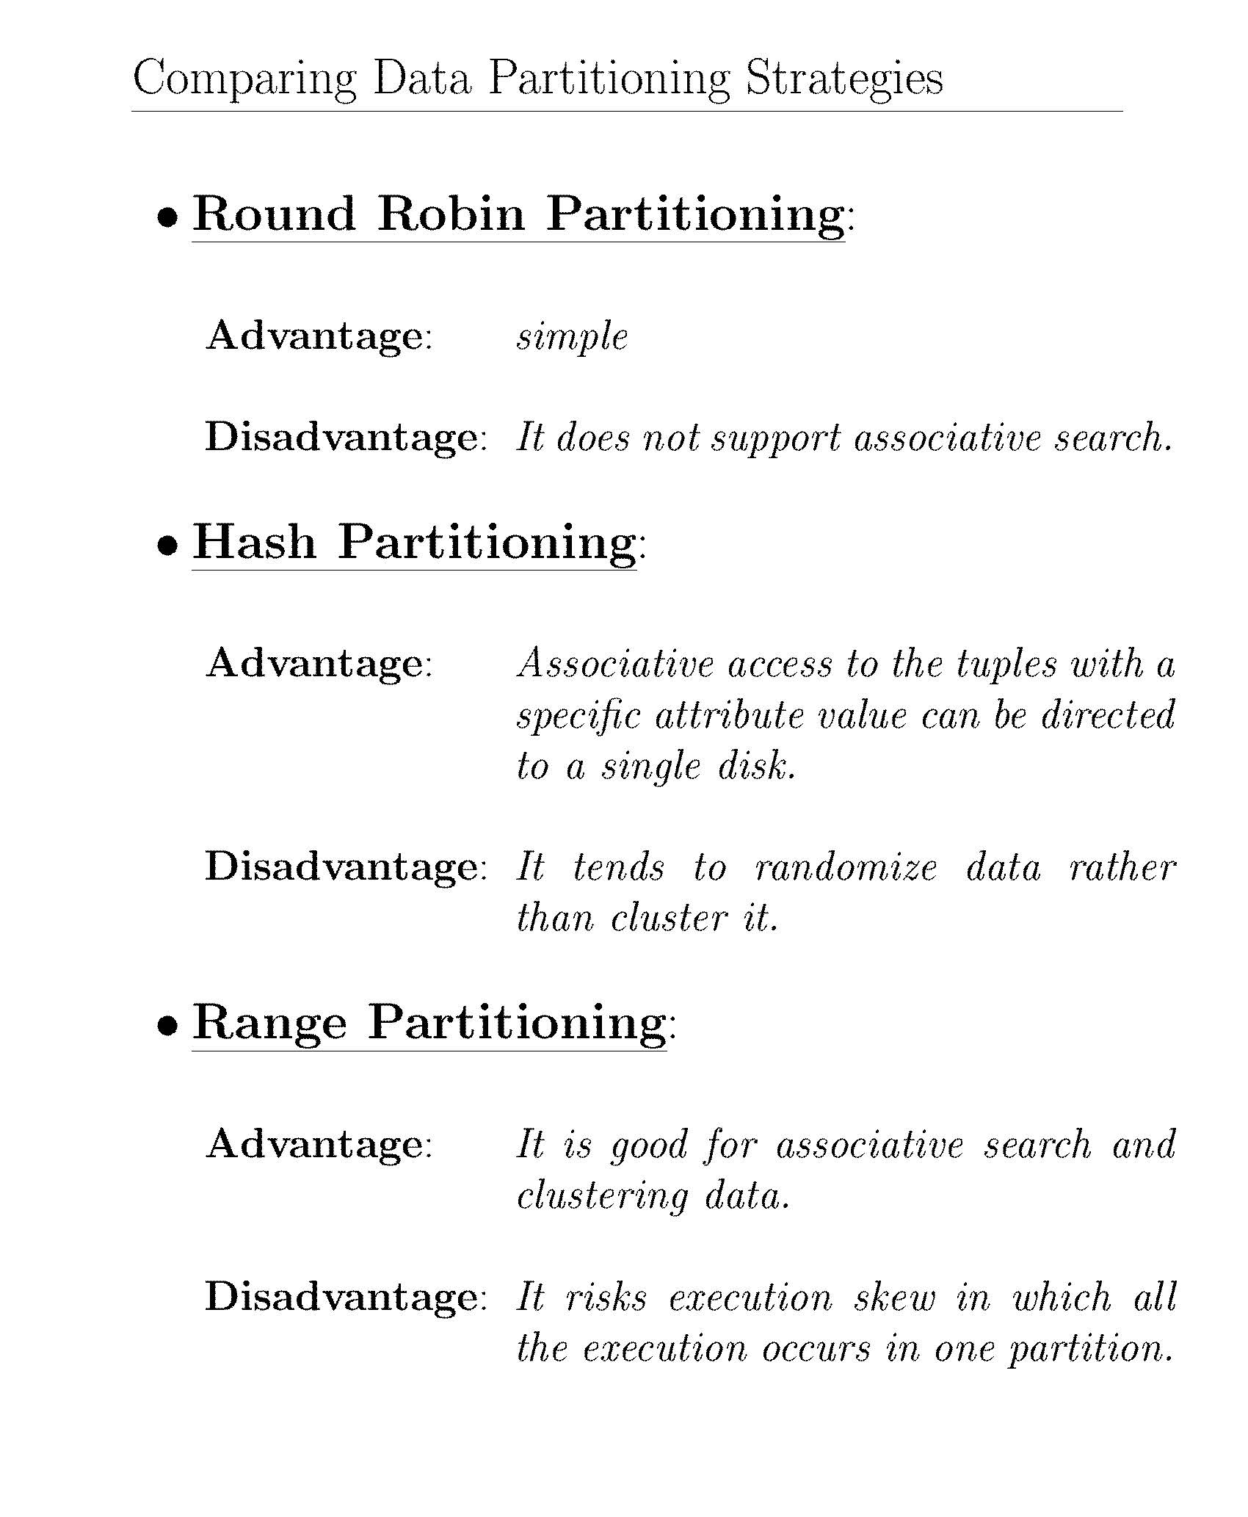

Slide 37
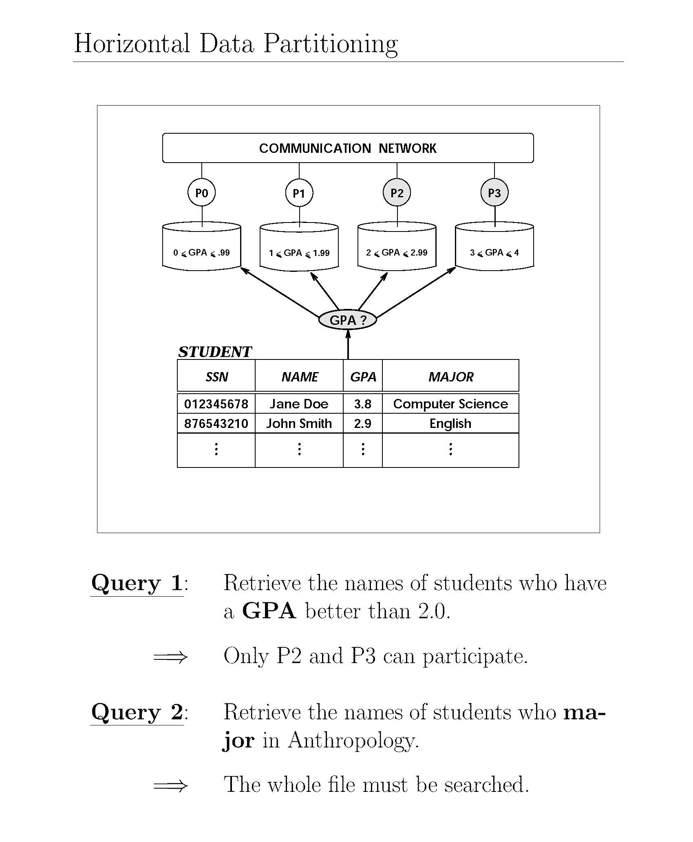

Slide 38
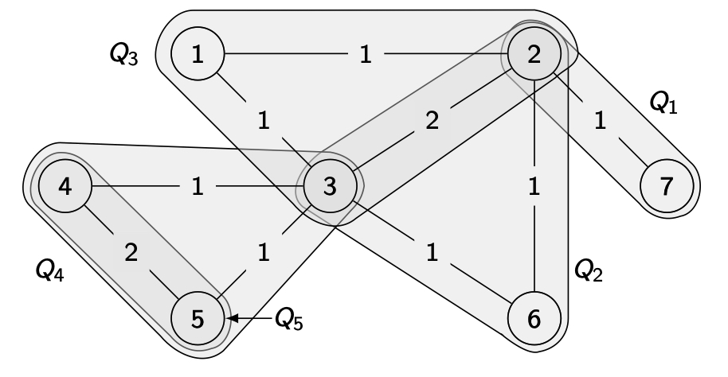
Workload-Aware Partitioning
Example: Schism
Graph G=(V,E) where
vertex v_{i} ∈ V represents a tuple in database,
edge e=(v_{i},v_{j}) ∈ E represents a query that accesses both tuples v_{i} and v_{j};
each edge has weight counting the no. of queries that access both tuples
Notes:
This is based on a graph.
Circles - 1,2,3,4,5,6,7 (node) are tuples.
Edge -> Query accessing both the tuples.

Slide 39
Schism: Workload-Aware Partitioning
Let us consider one relation consisting of seven tuples that are accessed by five queries.
There are seven vertices corresponding to the tuples, and the queries that access them together are shown as cliques (subset of vertices).
For example, query Q₁ accesses tuples 2 and 7, query Q₂ accesses tuples 2, 3, and 6, query Q₃ accesses tuples 1, 2, and 3, query Q₄ accesses tuples 3, 4, and 5, and query Q₅ accesses tuples 4 and 5.
Edge weights capture
the number of query accesses.

Slide 40
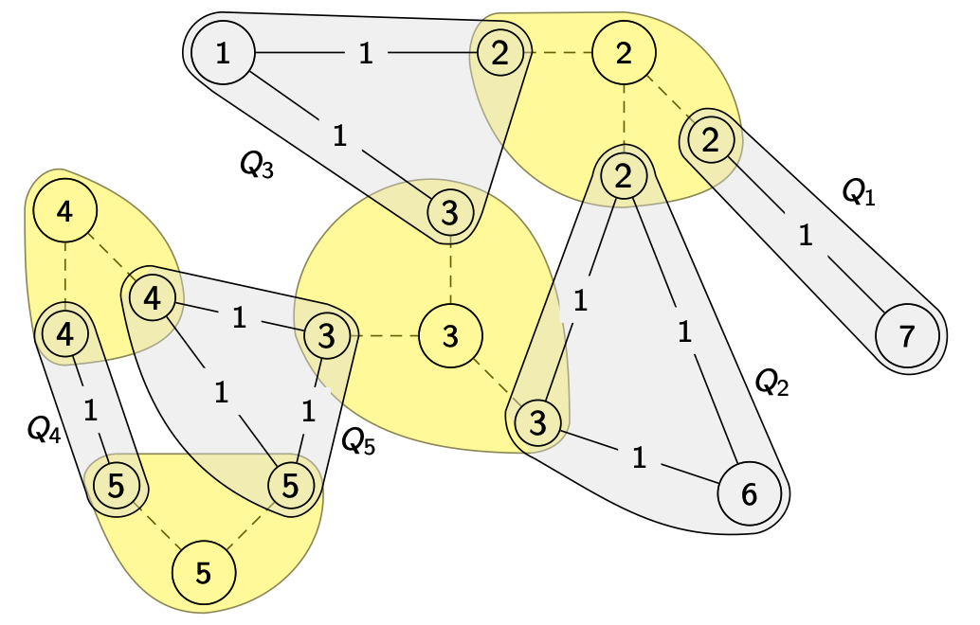
Schism: Incorporating Replication
Replication can be incorporated into this graph; this is shown below.

Slide 41
Schism: Incorporating Replication
Note that tuples 1, 6, and 7 are not replicated since they are only accessed by one query each, tuples 4 and 5 are replicated twice, and tuples 2 and 3 are replicated three times.
We represent the “replication edges” between the central vertex and each physical copy by dashed lines.

Slide 42
Schism
The next step is to perform a vertex-disjoint graph partitioning
Vertex-disjoint partitioning allocates each vertex of the graph to a separate partition such that partitions are mutually exclusive.
These algorithms have, as their objective function, a balanced (or nearly balanced) set of partitions while minimizing the cost of edge cuts.
The cost of an edge cut takes into account the weights of each edge so as to minimize the number of distributed queries.

Slide 43
Schism: Advantage and Disadvantage
The advantage of the Schism is its fine-grained allocation—it treats each tuple as an allocation unit.
Thus, the mapping of sets of tuples to queries can be controlled and many of them can execute at one site.
The downside of the approach is that the graph becomes very large as the database size increases, in particular when replicas are added to the graph.
This makes the management of the graph difficult and its partitioning expensive.

Slide 44
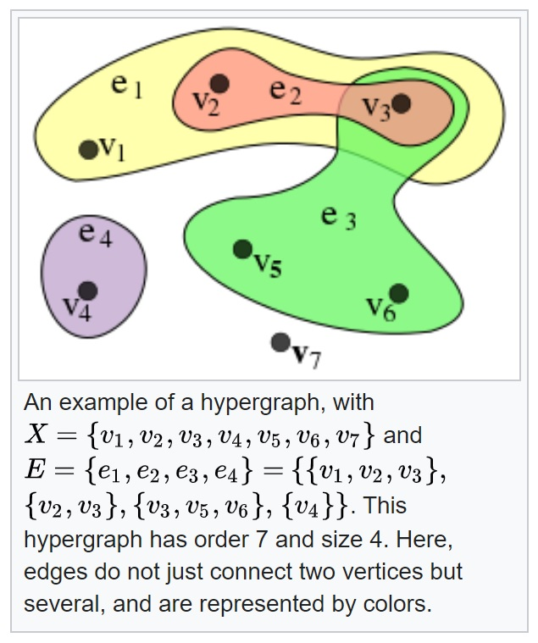
Hypergraph
Hypergraph is a generalization of a graph in which an edge can join any number of vertices. In contrast, in an ordinary graph, an edge connects exactly two vertices.
Formally, a hypergraph H is a pair H = (X, E) where X is a set of elements called nodes or vertices, and E is a set of non-empty subsets of X called hyperedges.
The size of the vertex set is called the order of the hypergraph, and the size of edges set is the size of the hypergraph.
https://en.wikipedia.org/wiki/Hypergraph
Notes:
In this 1 edge is connected to more than 2 nodes.

Slide 45
SWORD (Scalable Workload-Aware Data Placement for Transactional Workloads)
To reduce large graph, SWORD can be used.
Each hyperedge represents one query, and
The set of vertices spanned by the hyperedge represents the tuples accessed by it.
Each hyperedge has a weight that represents the frequency of that query in the workload. Therefore, what we have is a weighted hypergraph.
This hypergraph is then partitioned using a k-way balanced min-cut partitioning algorithm that produces k balanced partitions, each of which is allocated to a site.
This minimizes the number of distributed queries since the algorithm is minimizing the cuts in hyperedges and each of these cuts indicates a distributed query

Slide 46
SWORD
This model is not sufficient to address the issues discussed above.
To reduce the size of the graph, and the overhead of maintaining the associated mapping table, SWORD compresses this hypergraph as follows.
The set of vertices V in the original hypergraph G is mapped to a set of virtual vertices V´ using a hash or other function that operates on the primary keys of the tuples.
Once the set of virtual vertices are determined, the edges in the original hypergraph are now mapped to hyperedges in the compressed graph (E´ )

Slide 47
SWORD
To make sense for this compression, |V´ | < |V |, a critical issue is to determine how much compression is desired—
too much compression will reduce the number of virtual vertices,
but will increase the number of hyperedges, and therefore the number of distributed queries.
The resulting compressed hypergraph G´ = (V´ , E´) is going to be smaller than the original hypergraph so
easier to manage and partition, and
the mapping tables will also be smaller since they will only consider the mapping of sets of virtual vertices.

Slide 48
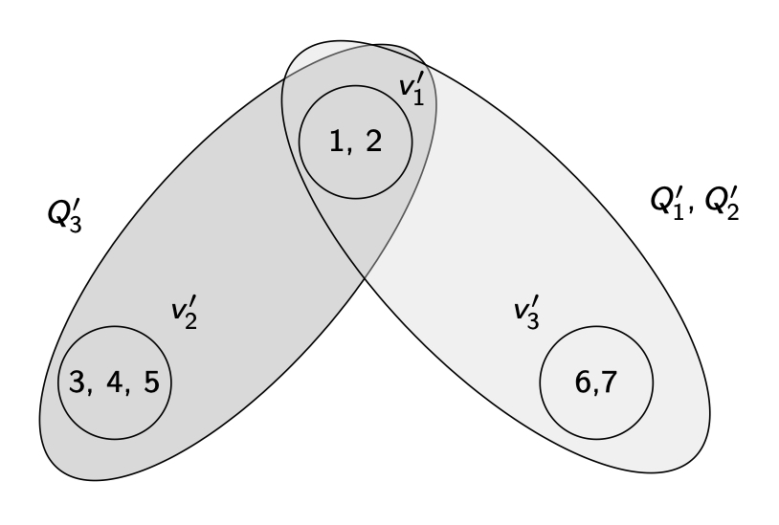
SWORD
We are compressing the hypergraph into three virtual vertices: v₁´ = 1, 2, v₂´ = 3, 4, 5, v₃´ = 6, 7.
There would be two hyperedges:
e₁´ = (v₁´ , v₃´ ) (corresponding to Q₁ and Q₂ in the original hypergraph) and
e₂´ = (v₁´ , v₂´ ) (corresponding to Q₃).
The hyperedges representing queries Q4 and Q5 would be local (i.e., not spanning virtual vertices) so no hyperedges are required in the compressed hypergraph.
e₂´
e₁´
Notes:
This graph represents the workload.
This is just an example, it can be done differently.

Slide 49
Multidimensional Data Placements
Hilbert Curve Allocation Method (HCAM)
Coordinated Modulo Declustering (CMD)
Multidimensional Data Partitioning (MDP)
General Multidimensional Data Allocation (GeMDA)

Slide 50
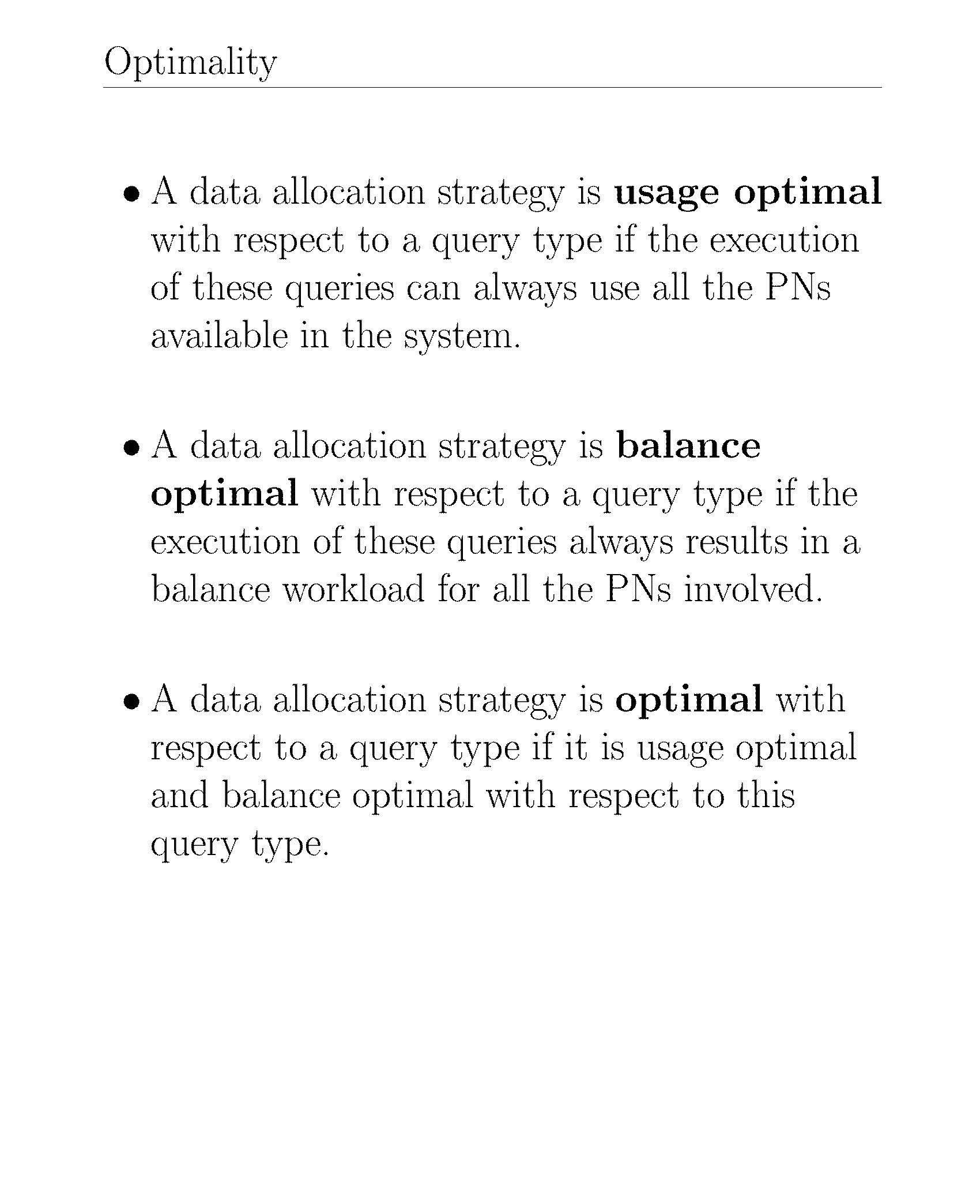
Notes:
PN means processing unit (all 3 together).

Slide 51
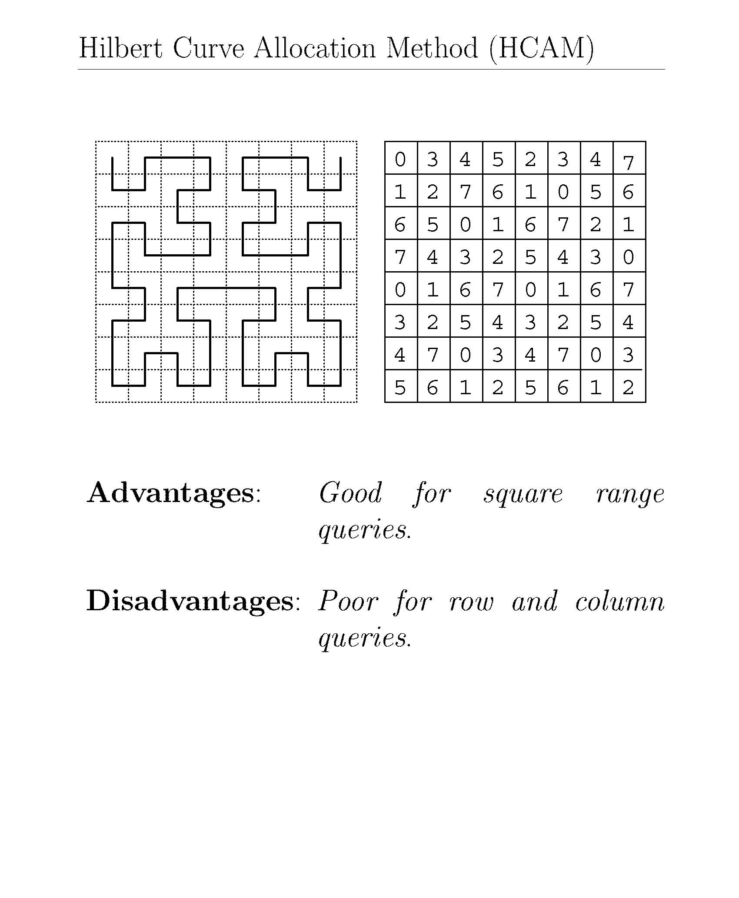
Notes:
Consider multiple attributes for data participation.
Square means square shape.
0,0,0,0 means only one processing unit is running that query.
Row and Column the unit is getting repeated, but we want same unit.

Slide 52
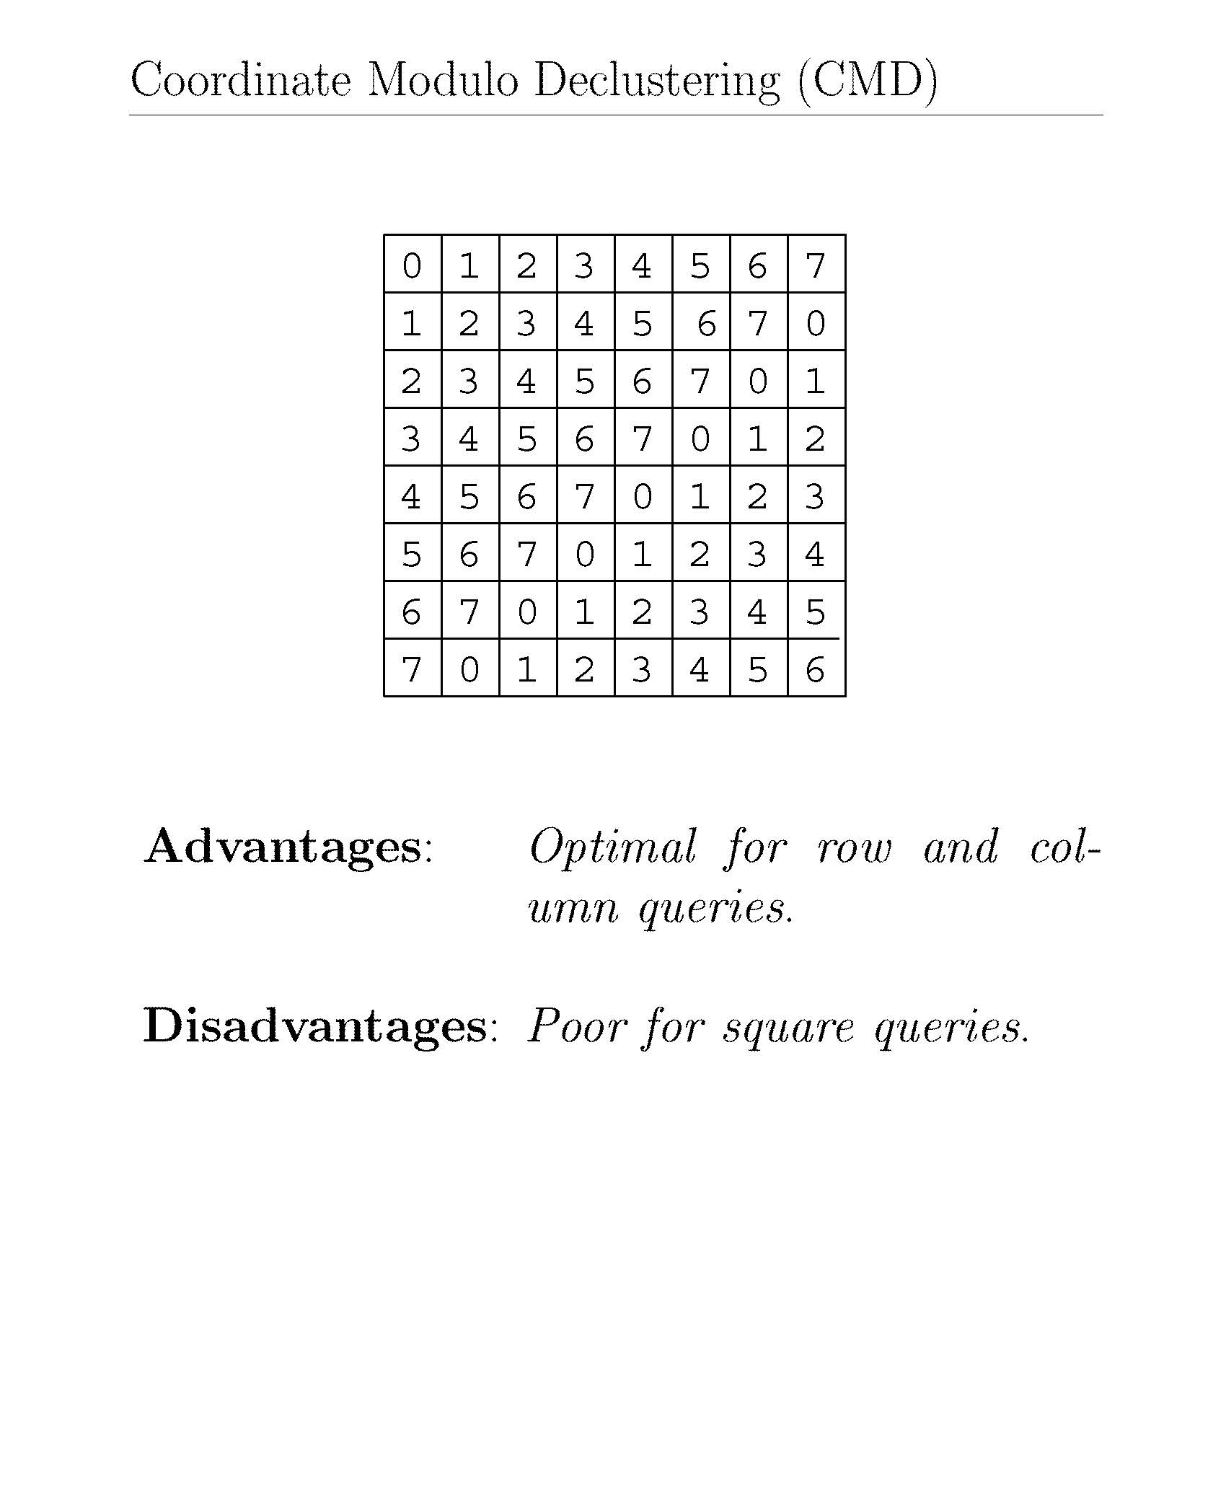
s
Notes:
All the numbers in row and column are different, but for squares its repeating.

Slide 53
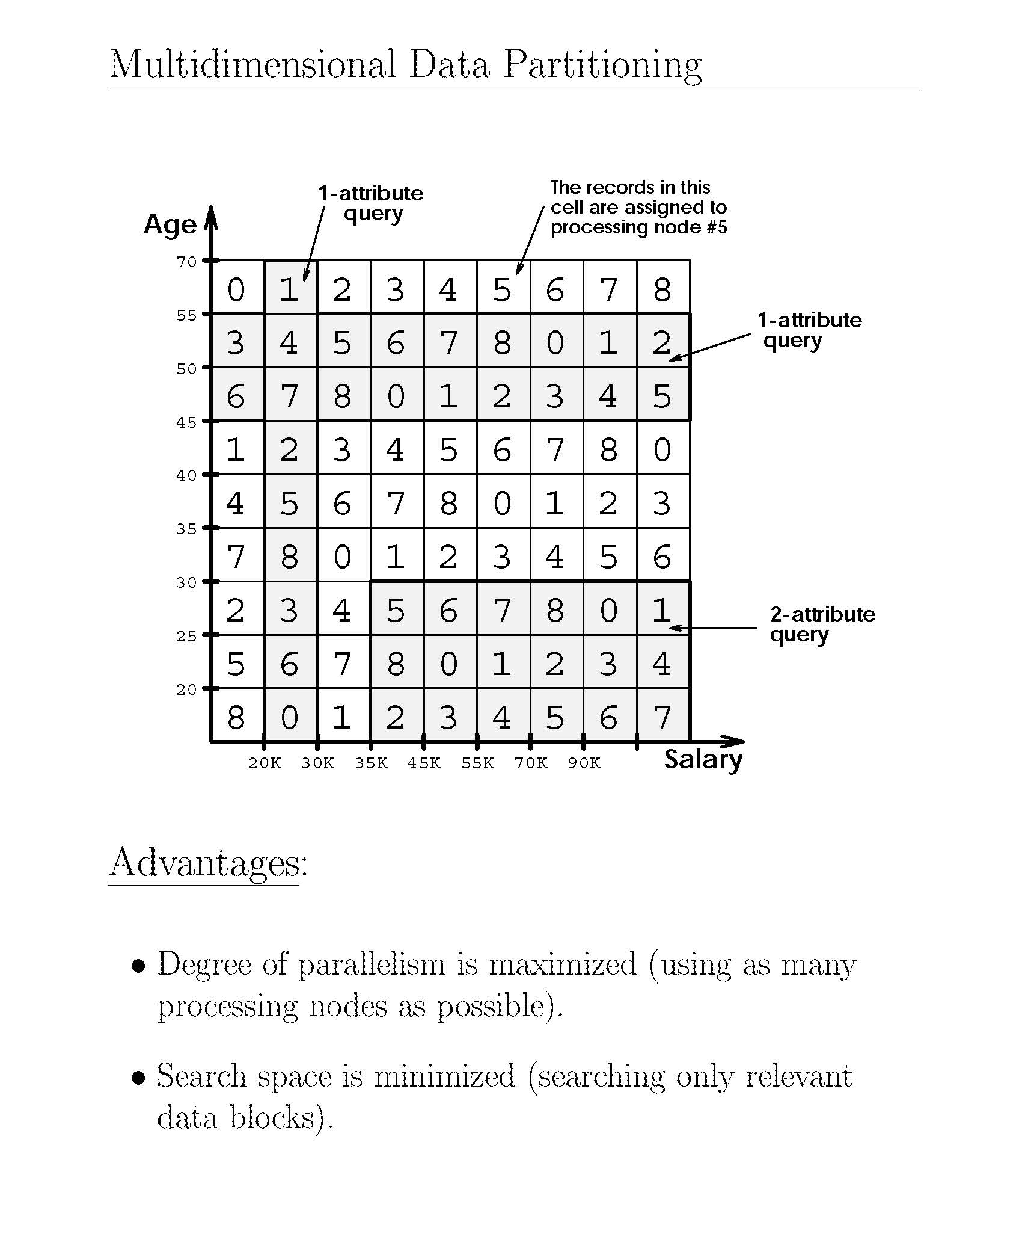
Notes:
Salary less than 20k and age between 55 and 70 is in processing unit 0.

Slide 54
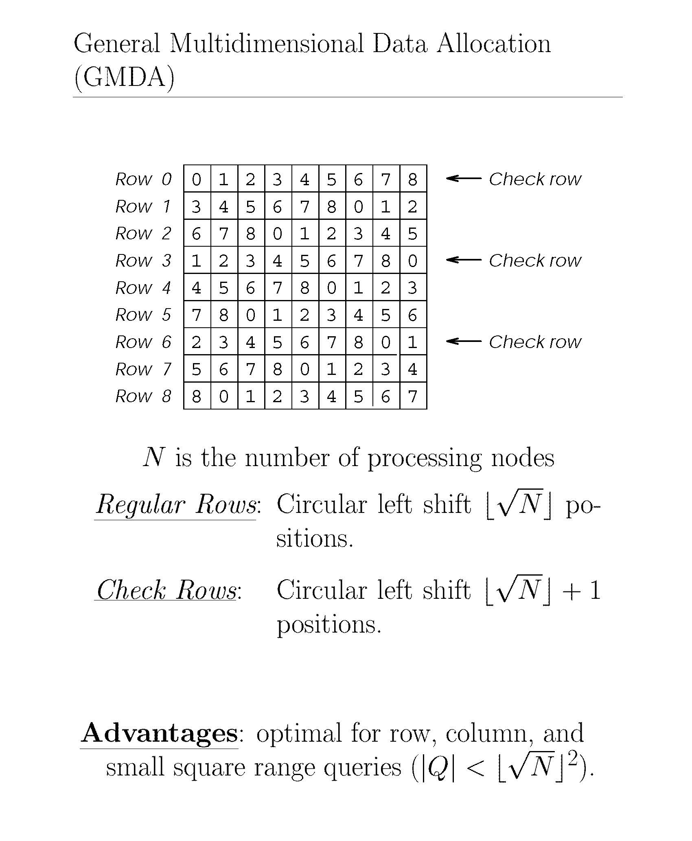
-------------------
Notes:
Here N = 9 (0-8)
Square root (N) = 3
IMPORTANT FOR FINAL

Slide 55
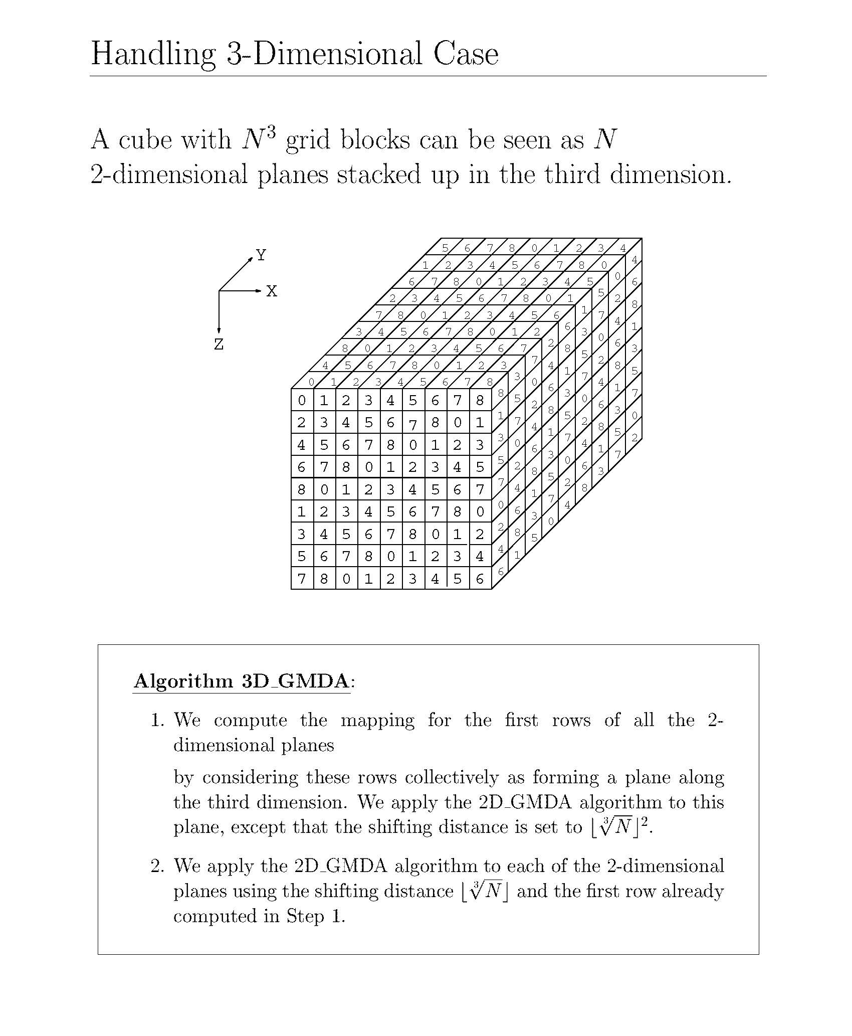
(4)
(2)
Notes:
If we have 3 dimensions then we use cube root.

Slide 56
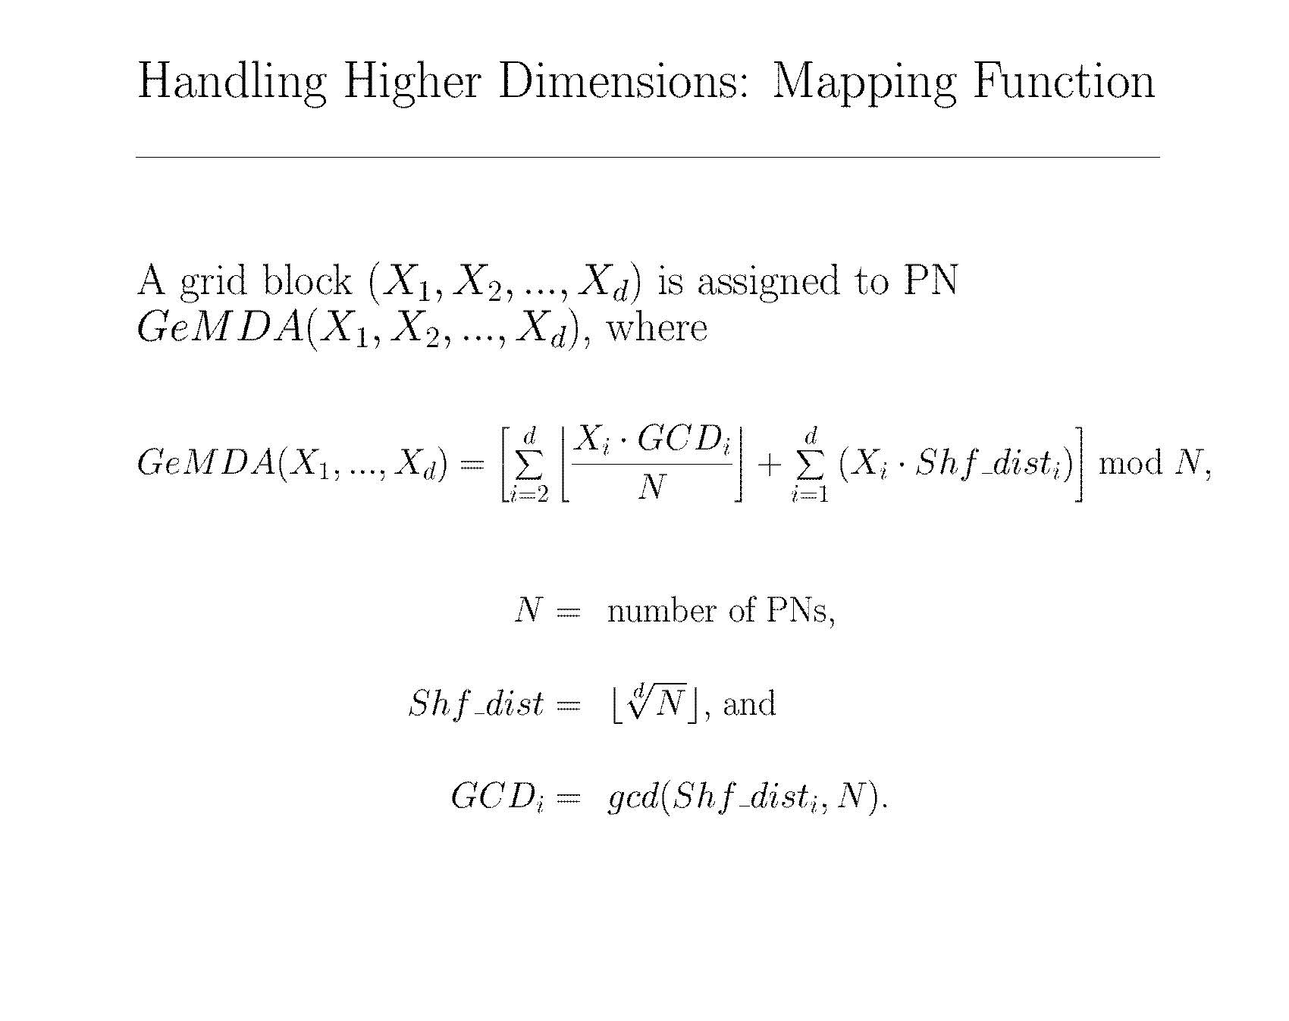

Slide 57
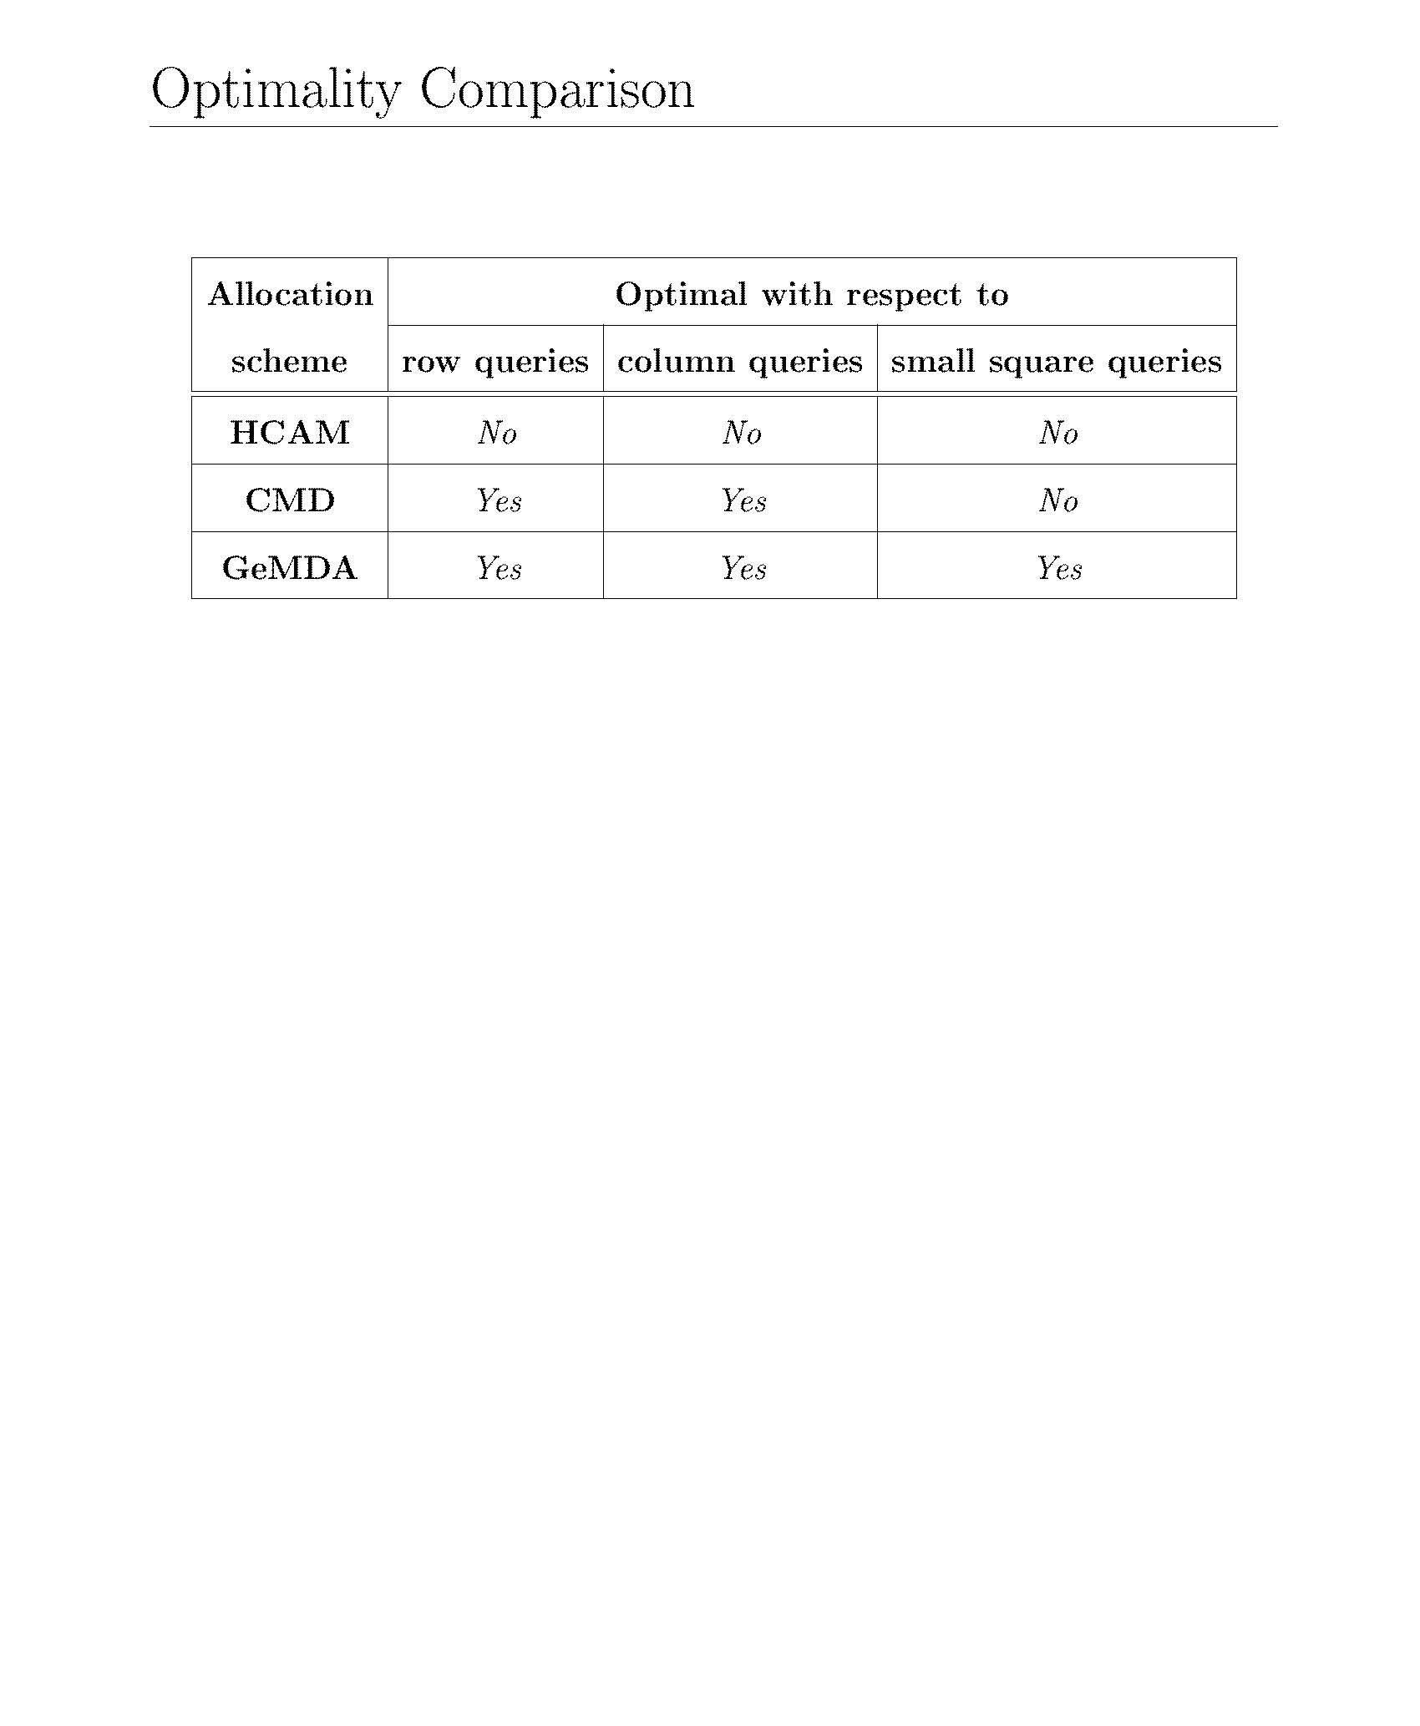

Slide 58
Replicated Data Partitioning
High-availability requires data replication
simple solution is mirrored disks
hurts load balancing when one node fails
more elaborate solutions achieve load balancing
interleaved partitioning (Teradata)
chained partitioning (Gamma)
Notes:
If we do partition, then we have replication of data for more reliability.
Mirror disk – Exactly the same (copy)

Slide 59
Interleaved Partitioning
primary copy of a partition, e.g., R₁, is further divided in three partitions, e.g., r_{1.1} r_{1.2} r_{1.3}, each at a different backup node.
In failure mode, the load of the primary copy gets balanced among the backup copy nodes.
But if two nodes fail, then the relation cannot be accessed thereby hurting availability.
Reconstructing the primary copy from its separate backup copies may be costly.
In normal mode, maintaining consistency may also be costly.
Node
1
2
3
4
Primary copy R₁ R₂ R₃ R₄
Backup copy r_{1.1} r_{1.2} r_{1.3}
r_{2.3} r_{2.1} r_{2.2}
r_{3.2} r_{3.3} r_{3.1}
r_{4.1} r_{4.2} r_{4.3}
Notes:
IMPORTANT FOR THE FINAL EXAM
Adv: One node fails, still we can still retrieve data.
But if 2 nodes fail then we cannot retrieve complete data. But 2 2-node fail condition is rare.

Slide 60
Chained Partitioning
It stores the primary and backup copy on two adjacent nodes.
The main idea is that the probability that two adjacent nodes fail is much lower than the probability that any two nodes fail.
In failure mode, the load of the failed node and the backup nodes are balanced among all remaining nodes by using both primary and backup copy nodes.
In addition, maintaining copy consistency is cheaper.
Node
1
2
3
4
Primary copy R₁ R₂ R₃ R₄
Backup copy r₄ r₁ r₂ r₃
Notes:
If node 1 and 3 fails still we can retrieve data.
But if 2 adjacent nodes (like 1,3 or 2,4) fail then we cannot retrieve data. (But it's rare)

Slide 61
Parallel Database Systems
Parallel DB Architecture
Parallel Data placement
Parallel Query processing
Load balancing
Database clusters

Slide 62
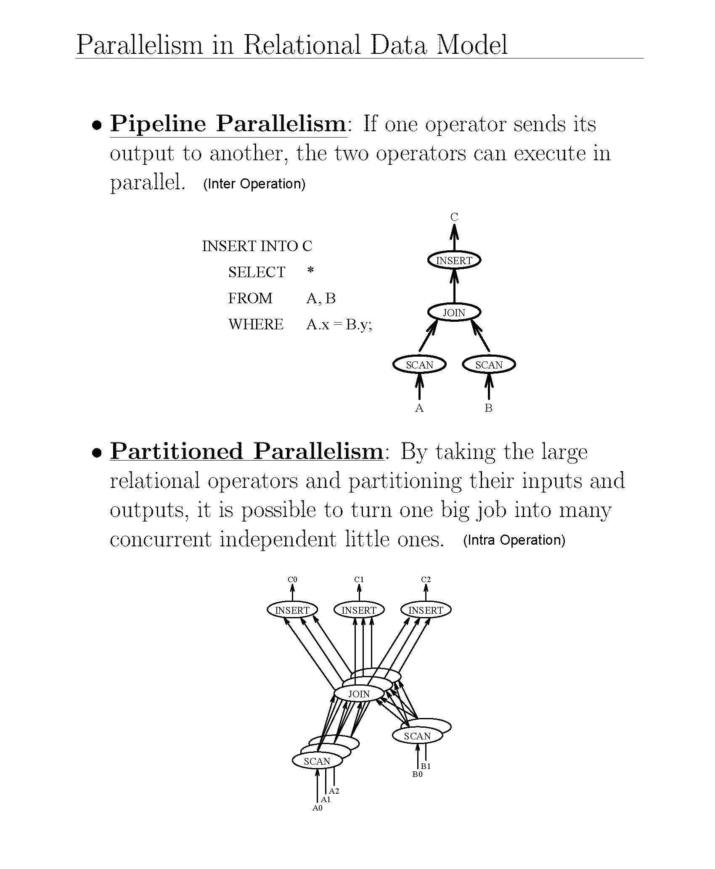
Notes:
The pipeline is inter.
We can run SCAN in parallel.
Partitioned is intra
SCAN and JOIN can be done simultaneously

Slide 63
Data-based Parallelism
Inter-operation parallelism
p operations of the same query in parallel
op.3
op.1
op.2
Intra-operation parallelism
The same op in parallel
op.
op.
op.
op.
op.
R
R₁
R₂
R₃
R₄

Slide 64
Parallel data processing
Should exploit intra-operator parallelism
Such as parallel algorithms for select and join operators, since all other binary operators (such as union) can be handled very much like join
The parallel processing of join is significantly more involved than that of select.
Parallel nested loop join: no special assumption
Parallel associative join: applies only for equijoin with one of the operand relations partitioned according to the join attribute
Parallel hash join: applies for equijoin but does not require any particular partitioning of the operand relations

Slide 65
Parallel Nested Loop Join
In the first phase, each fragment of R is sent and replicated at each node containing a fragment of S. This phase can be done in parallel.
In the second phase, each S-node j receives relation R entirely, and locally joins R with fragment S_{j} . This phase is done in parallel.
node 1
node 2
R₁:
R₂:
S₁
S₂
node 3
node 4
Notes:
Fragmented:
R -> R1, R2
S -> S1, S2 (Divided randomly – no assumption)
Red can be done simultaneously.
Green can also be done in parallel

Slide 66
Parallel Associative Join
Assume the equijoin predicate is on attribute A from R, and B from S.
Relation S is partitioned according to the hash function h applied to join attribute B, meaning that all the tuples of S that have the same value for h(B) are placed at the same node.
In the first phase, relation R is sent associatively to the S-nodes based on the hash function h applied to attribute A. The first phase is done in parallel.
node 1
node 2
R₁:
R₂:
S₁
S₂
node 3
node 4
Notes:
There is an assumption.
S1 and S2 are divided by applying the hash function.
Attribute A in R and attribute B in S are joint attributes, which means that the attributes are the same.
The amount of join here is less because it is not complete R.

Slide 67
Parallel Associative Join
This guarantees that a tuple of R with hash value v is sent only to the S-node that contains tuples with hash value v.
In the second phase, each S-node j receives in parallel from the different R-nodes the relevant subset of R (i.e., R_{j}) and joins it locally with the fragments S_{j}.
Local join processing can be done as in the parallel.
node 1
node 2
R₁:
R₂:
S₁
S₂
node 3
node 4

Slide 68
Parallel Hash Join
node 1
node 2
node 3
node 4
R₁:
R₂:
S₁:
S₂:
node 1
node 2
It can be viewed as a generalization of the parallel associative join algorithm.
The partitioning of R and S can be based on the same hash function applied to the join attribute.
Each individual join is done in parallel, and the join result is produced at p nodes.
The main difference with the parallel associative join algorithm is that partitioning of S is necessary,
Notes:
This is the general view of associative join.
The idea is the same.

Slide 69
Parallel Query Optimization
The objective is to select the “best” parallel execution plan for a query using the following components
Search space
Models alternative execution plans as operator trees
Left-deep vs. Right-deep vs. Bushy trees
Search strategy
Dynamic programming -Deterministic for small search space
Randomized for large search space
Cost model
Physical schema info. (partitioning, indexes, etc.)
Statistics and cost functions
The total time of a plan can be computed by a formula that simply adds all CPU, I/O and communication cost components as in distributed query optimization
Notes:
If a query is given then we make a query tree make different plans and pick the plan with minimum cost.
How do we get different plans? - Using search space, search strategy.

Slide 70
Search Space: Execution Plans as Operator Trees
Result
Result
j3
j6
Left-deep
j2
R4
R4
j5
Right-deep
j1
R3
R3
j4
R1
R2
R1
R2
Result
Result
j9
R4
j12
Bushy
Zig-zag
j8
j10
j11
j7
R3
R1
R2
R3
R4
R1
R2

Slide 71
Search Strategies
⋈
Deterministic
⋈
⋈
R₄
⋈
⋈
R₃
⋈
R₃
R₁
R₂
R₁
R₂
R₁
R₂
Randomized
⋈
⋈
⋈
R₃
⋈
R₂
R₁
R₂
R₁
R₃

Slide 72
Parallel Query Optimization
Cost model
To estimate the cost of an execution plan, the cost model uses database statistics and organization information, such as relation cardinalities and partitioning, as with distributed query optimization.
The total time of a plan can be computed by a formula that simply adds all CPU, I/O and communication cost components as in distributed query optimization

Slide 73
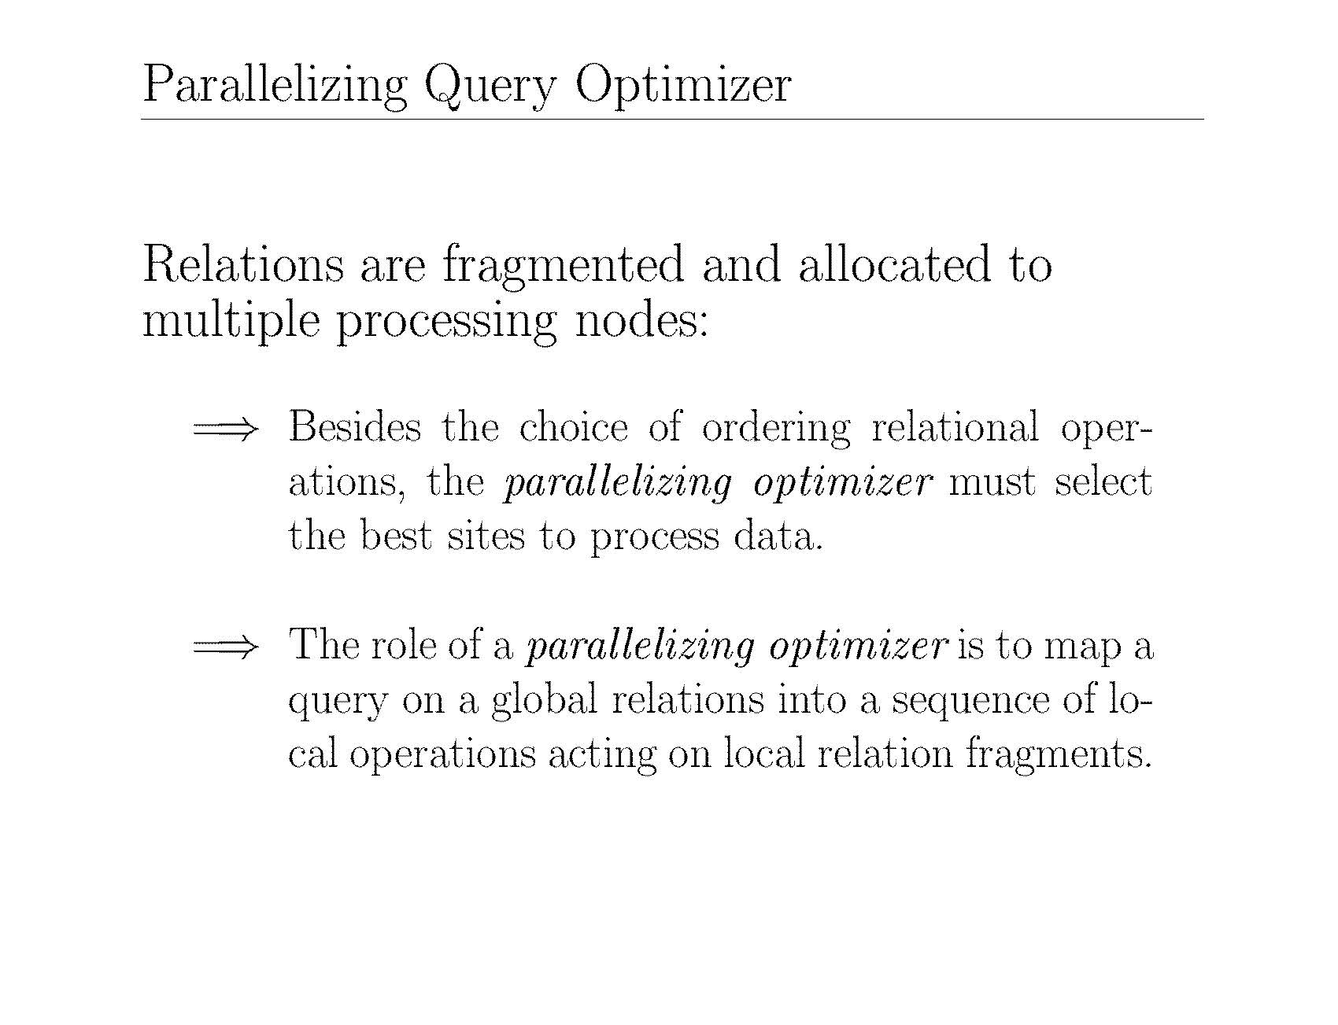

Slide 74
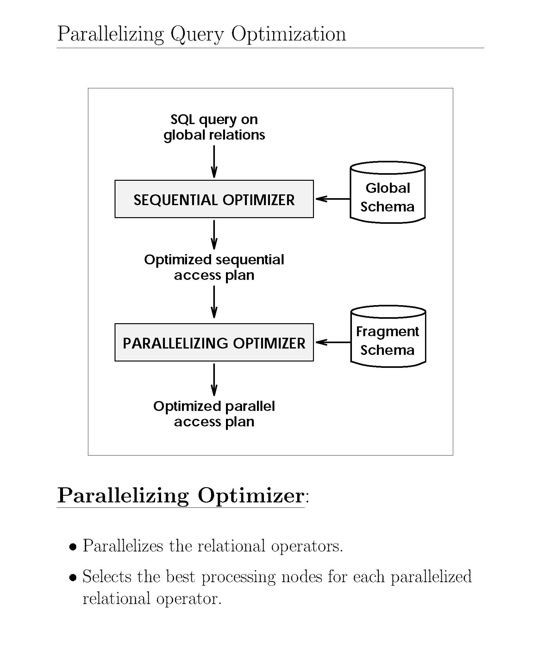

Slide 75
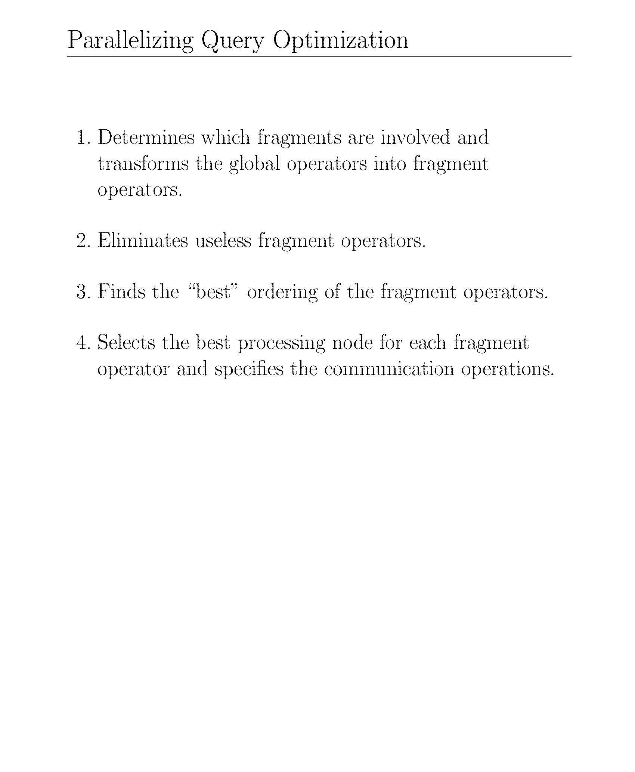

Slide 76
Parallel Database Systems
Parallel DB Architecture
Parallel Data placement
Parallel Query processing
Load balancing
Database clusters

Slide 77
Load Balancing
Good load balancing is crucial for the performance of a parallel system.
The response time of a set of parallel operators is that of the longest one.
Thus, minimizing the time of the longest one is important for minimizing response time.
Balancing the load of different queries among different nodes is also essential to maximize throughput.
Load balancing problems can appear with intra-operator parallelism (variation in partition size), namely data skew, and inter-operator parallelism (variation in the complexity of operators).
Notes:
Because we need to use all of the nodes the load balancing is necessary.

Slide 78
Parallel Execution Problems
Initialization
Before the execution takes place, an initialization step is necessary. This first step is generally sequential.
It includes process (or thread) creation and initialization, communication initialization, etc.
The duration of this step is proportional to the degree of parallelism and can actually dominate the execution time of simple queries, e.g., a select query on a single relation.
Maximizing the degree of parallelism for an operator can hurt speed-up because of the overhead of initialization.
Thus, the degree of parallelism should be considered according to query complexity.

Slide 79
Parallel Execution Problems
Interferences
A highly parallel execution can be slowed down by interference. Interference occurs when several processors simultaneously access the same resource, hardware or software.
A typical example of hardware interference is the contentions (conflicts) created on the bus of a shared-memory system. When the number of processors is increased, the number of conflicts on the bus increases, thus limiting the extensibility of shared-memory systems.
A solution to these interferences is to duplicate shared resources. For instance, disk access interference can be eliminated by adding several disks and partitioning the relations.
Notes:
Initialization takes a longer time if we use many parallel executions.

Slide 80
Parallel Execution Problems
Interferences
Software interference occurs when several processors want to access shared data.
A general solution to software interference is to partition the shared resource (data) into several independent resources (data).
Thus, two independent resources can be accessed in parallel, which reduces the probability of interference.
To further reduce interference on an independent resource (e.g., an index structure), replication can be used.
Thus, access to replicated resources can also be parallelized.
Notes:
Bus used for data transfer. If it misses one bus, or the bus is full then wait for another bus.
If both processor wants to use the same disk then it has more interference.
Why do they want to access the same disk? – because the data is present in that disk. – Solution is to replicate or partition the data.

Slide 81
Parallel Execution Problems
Problems arise for intra-operator parallelism with skewed data distributions
attribute data skew (AVS): inherent in the dataset (e.g., there are more citizens in Paris than in Waterloo)
tuple placement skew (TPS): introduced when the data are initially partitioned (e.g., with range partitioning)
op.
op.
op.
op.
op.
R
R₁
R₂
R₃
R₄
Notes:
Ex: If R has 400 tuples – divide into 4 partitions (100 each) – Then it is perfect.
For that, we cannot consider the content. We put the first 100 to 1st fragment, the next 100 to the next fragment, and so on.
Skew means sizes are different – Frangement 1 is big. (This is one way of skew)

Slide 82
Load Balancing
Problems arise for intra-operator parallelism with skewed data distributions
selectivity skew (SS): introduced when there is variation in the selectivity of select predicates on each node.
redistribution skew (RS): occurs in the redistribution step between two operators. It is similar to TPS.
join product skew (JPS): occurs because the join selectivity may vary between nodes.
Solutions
sophisticated parallel algorithms that deal with skew
dynamic processor allocation (at execution time)

Slide 83
Data Skew Example
JPS
JPS
Res1
Res2
AVS/TPS
Join1
Join2
AVS/TPS
S2
S1
RS/SS
RS/SS
AVS/TPS
Scan1
Scan2
AVS/TPS
R2
R1

Slide 84
Load Balancing in a DB Cluster
Choose the node to execute Q
round robin
The least loaded
Need to get load information
Fail over
In case a node N fails, N’s queries are taken over by another node
Requires a copy of N’s data or SD
In case of interference
Data of an overloaded node are replicated to another node
Q₄
Q₃
Q₂
Q₁
Load balancing
Q₁
Q₂
Q₃
Q₄
Notes:
This is a Queue data structure (FIFO).
If a certain node fails then we need to re-distribute the Query.

Slide 85
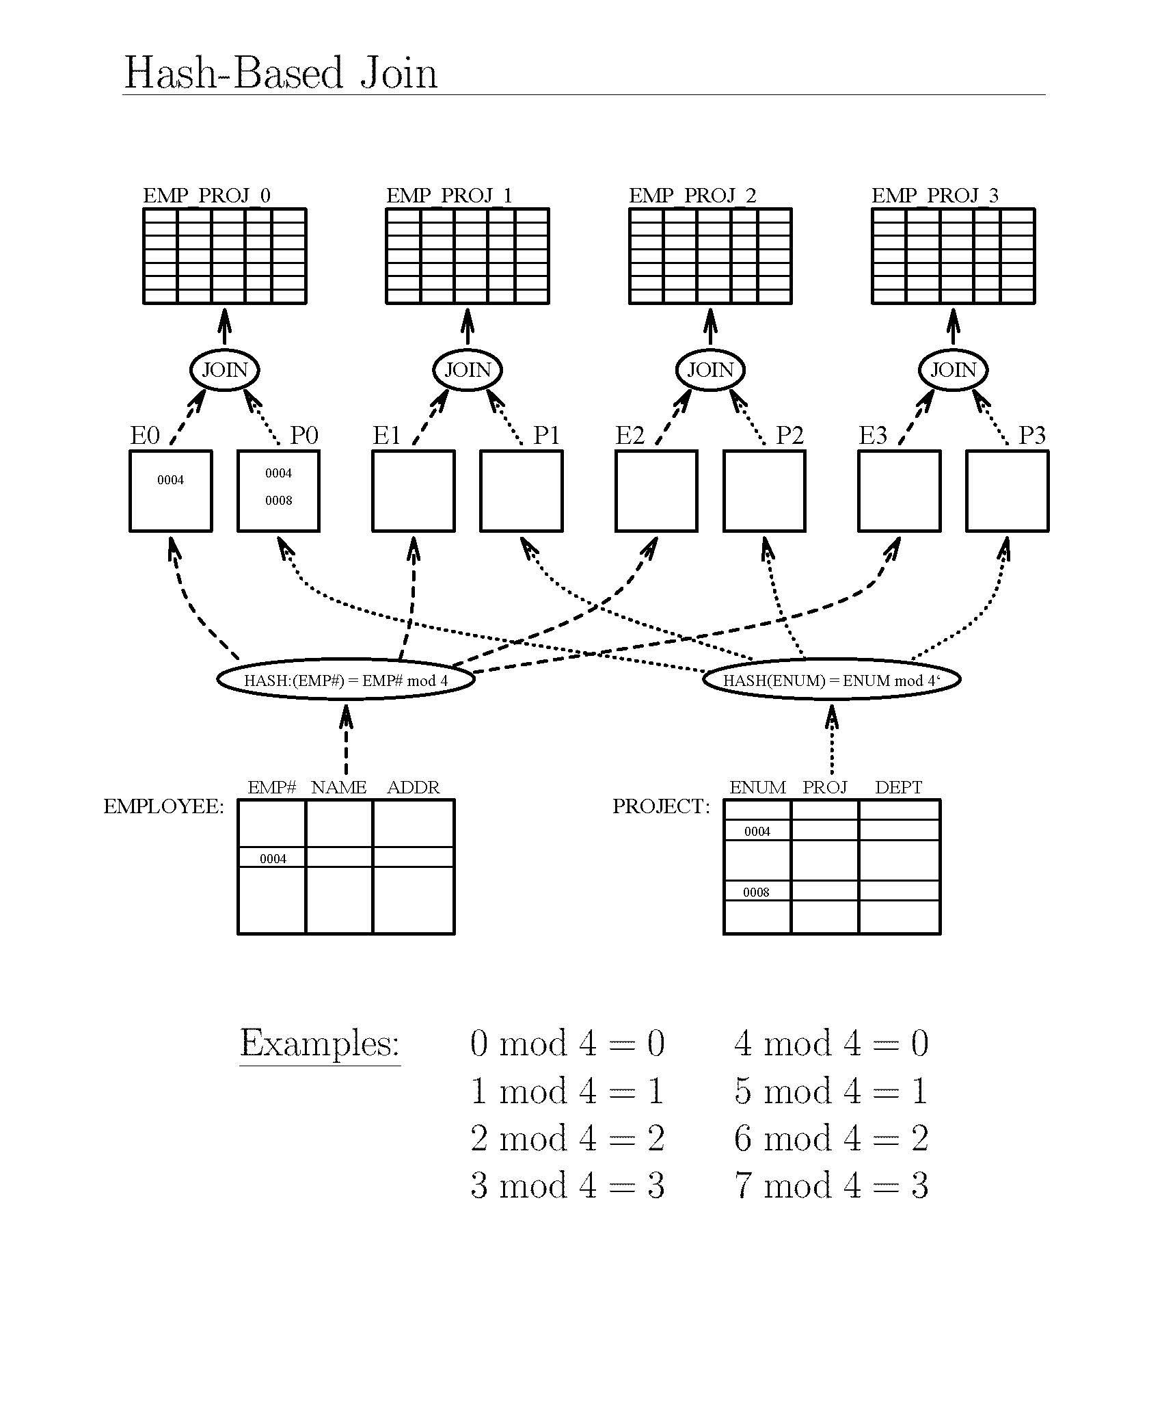
Notes:
Mod 4 because of 4 processing units.
This is a good way but it cannot guarantee load balancing.
This is a theoretical starting point.
The idea is how to run joins using multiple processors.
EMP or ENUM is the join attribute.

Slide 86
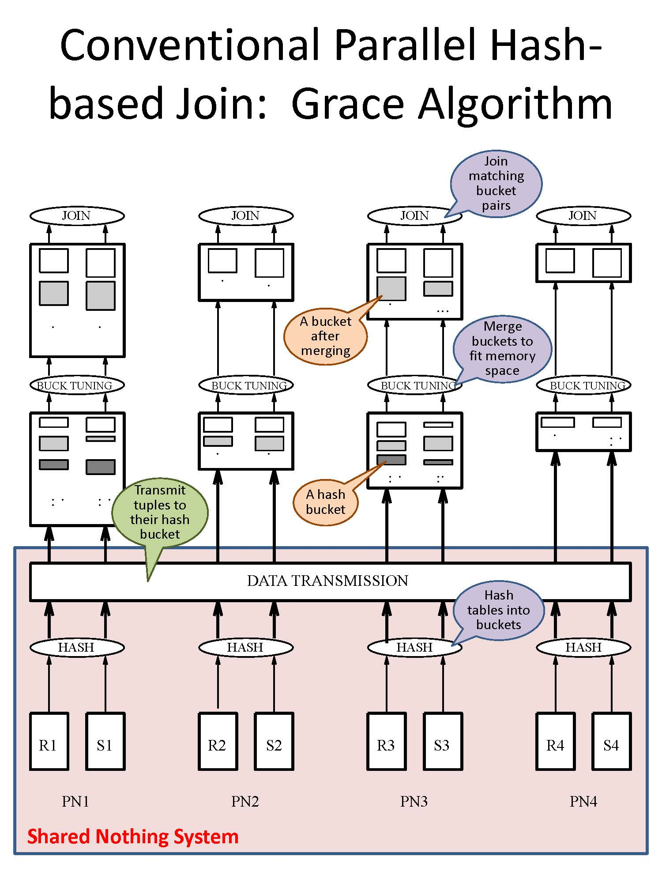
Notes:
Different sizes.
This is a practical starting point.
Hash functions are the same.
Some have more works load than other so people have proposed other technique like slide 87.

Slide 87
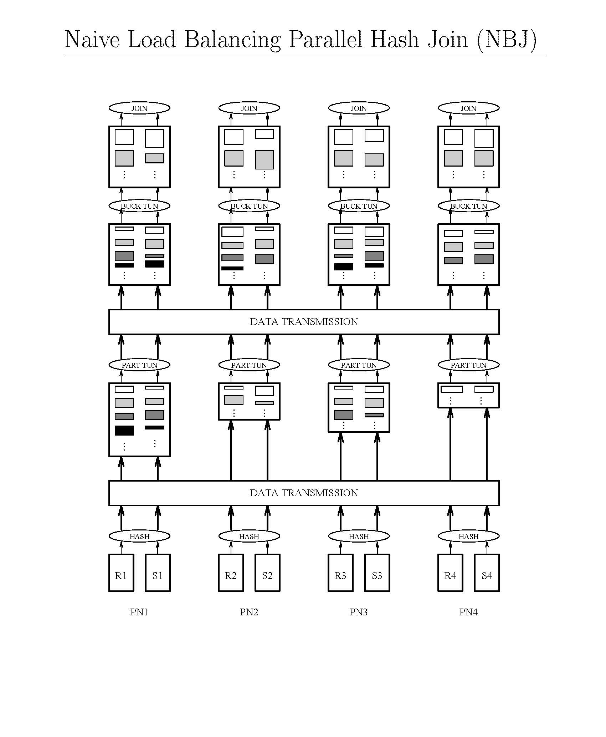
Partition tuning : Apply Different hash function
to partition more, and Bin packing
Notes:
Data transmission has been done 3 times.
So distribute again by data transmission.
Take a longer time because we have extra data transmission.

Slide 88
Bin Packing
Greedy strategy #1 “First Fit”:
Place each item in first bin large enough to hold it
If no such bin exists, get a new bin
Example: Items = 0.5, 0.2, 0.7, 0.8, 0.4, 0.1, 0.3
0.1
0.3
Uses 4 bins
Not optimal
0.2
0.7
0.8
0.4
0.5
Notes:
This is not optimal because we want all equally in all bins.

Slide 89
Bin Packing
Greedy strategy #2 “First Fit Decreasing”:
Sort items according to decreasing size
Place each item in first bin large enough to hold it
Example: Items = 0.5, 0.2, 0.7, 0.8, 0.4, 0.1, 0.3
= 0.8, 0.7, 0.5, 0.4, 0.3, 0.2, 0.1
0.1
Uses 3 bins
Optimal in this case
Not optimal in general
0.2
0.3
0.4
0.8
0.7
0.5
Notes:
2nd items are sorted.

Slide 90
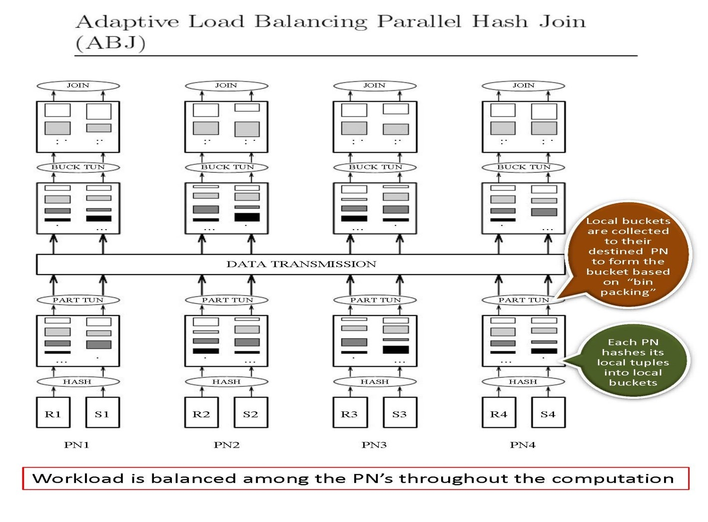
Notes:
Only one data transmission, so it is a little bit better.
The assumptions is that we started from the same size. (R1, S1, R2, ….)

Slide 91
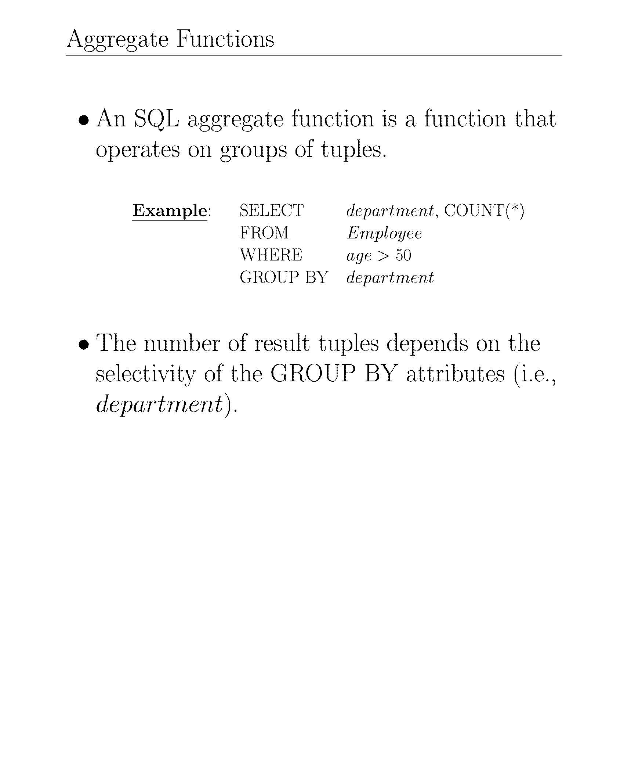

Slide 92
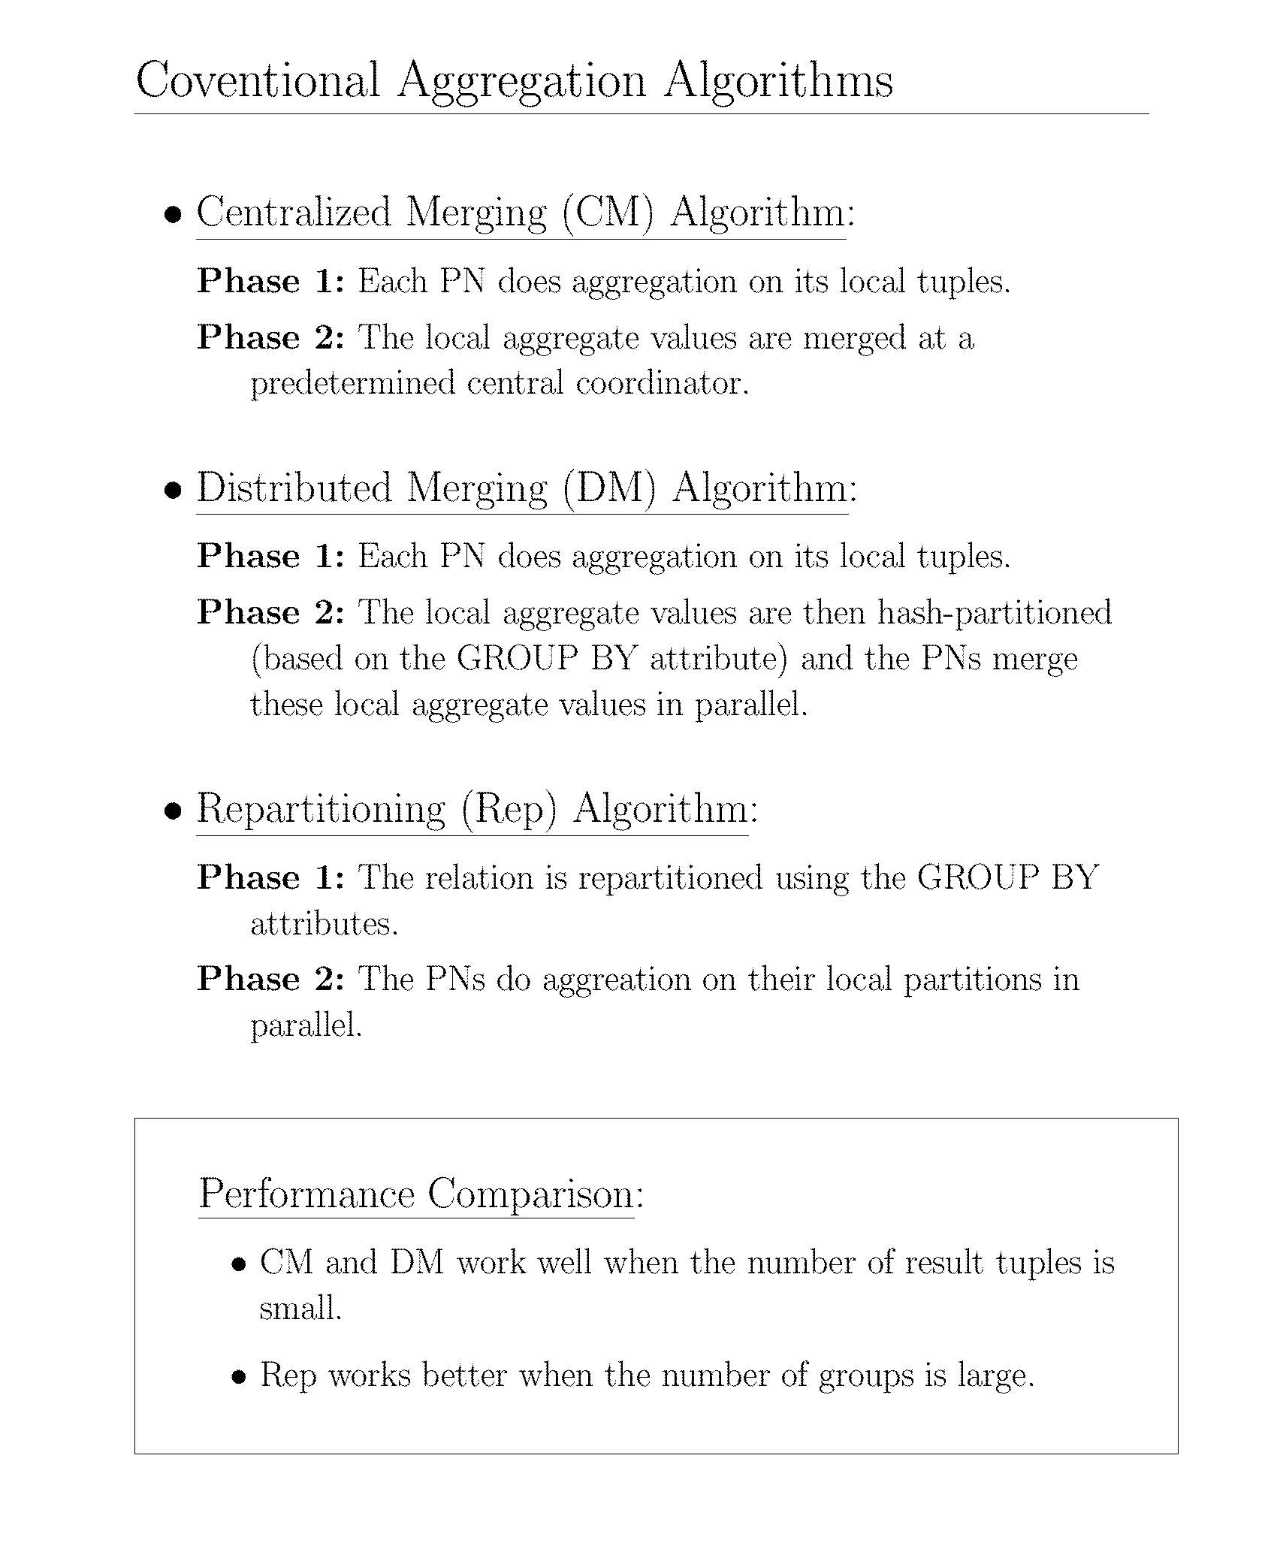

Slide 93
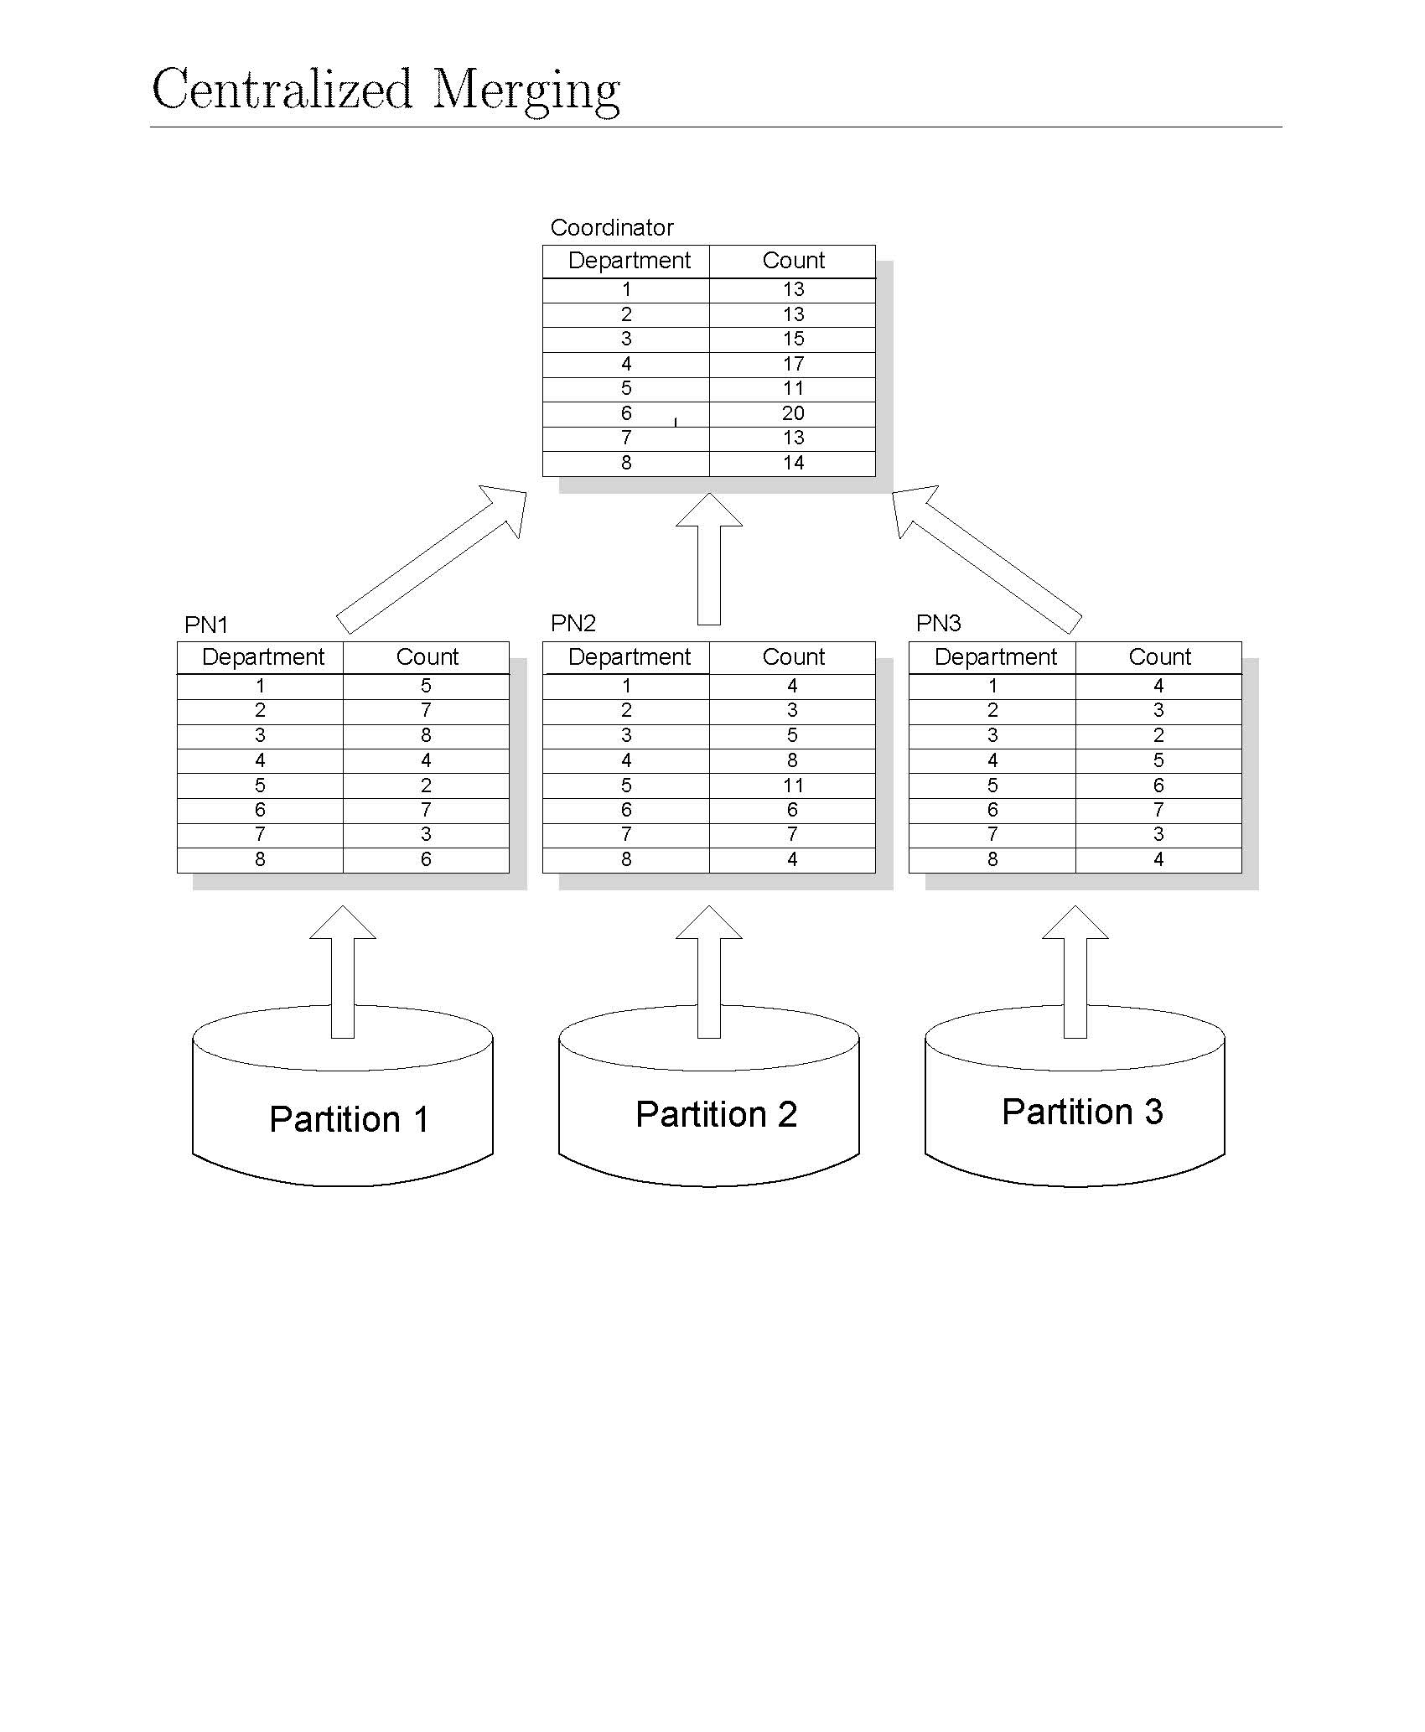
Notes:
The partitions are given to different processors and the results must be combined at the end.
3 processing nodes.

Slide 94
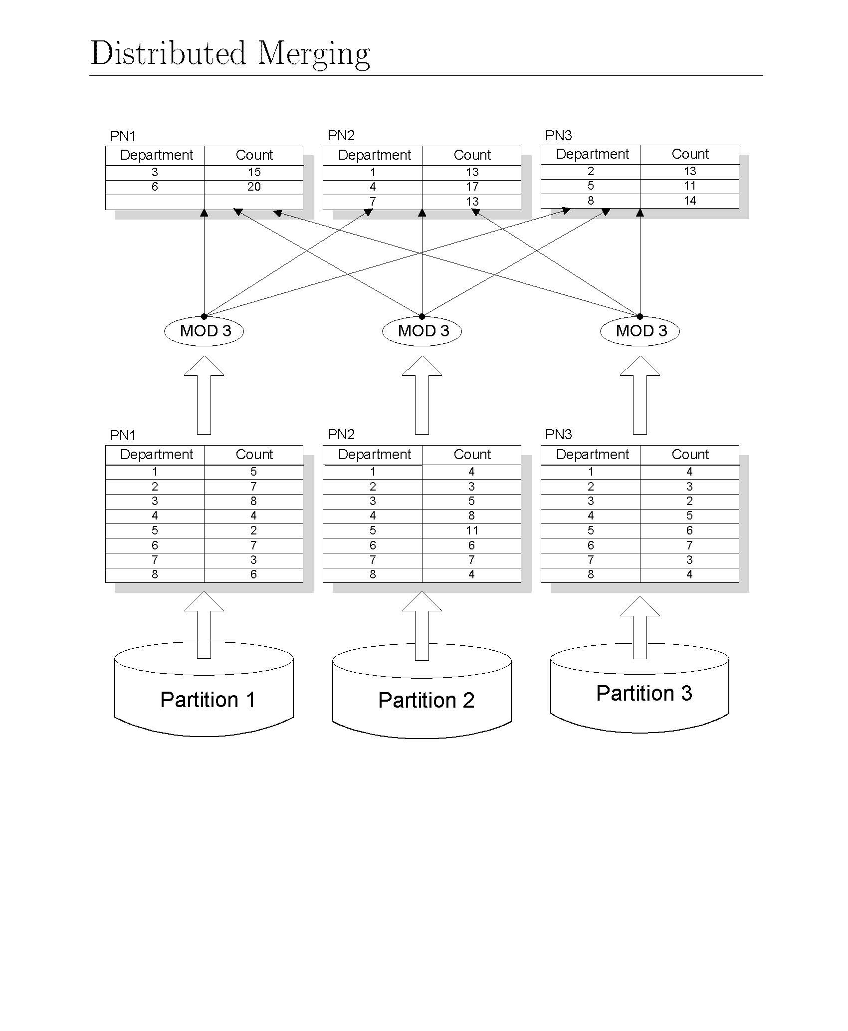
Notes:
Instead of all the results going to the single coordinator, we apply a hash function.

Slide 95
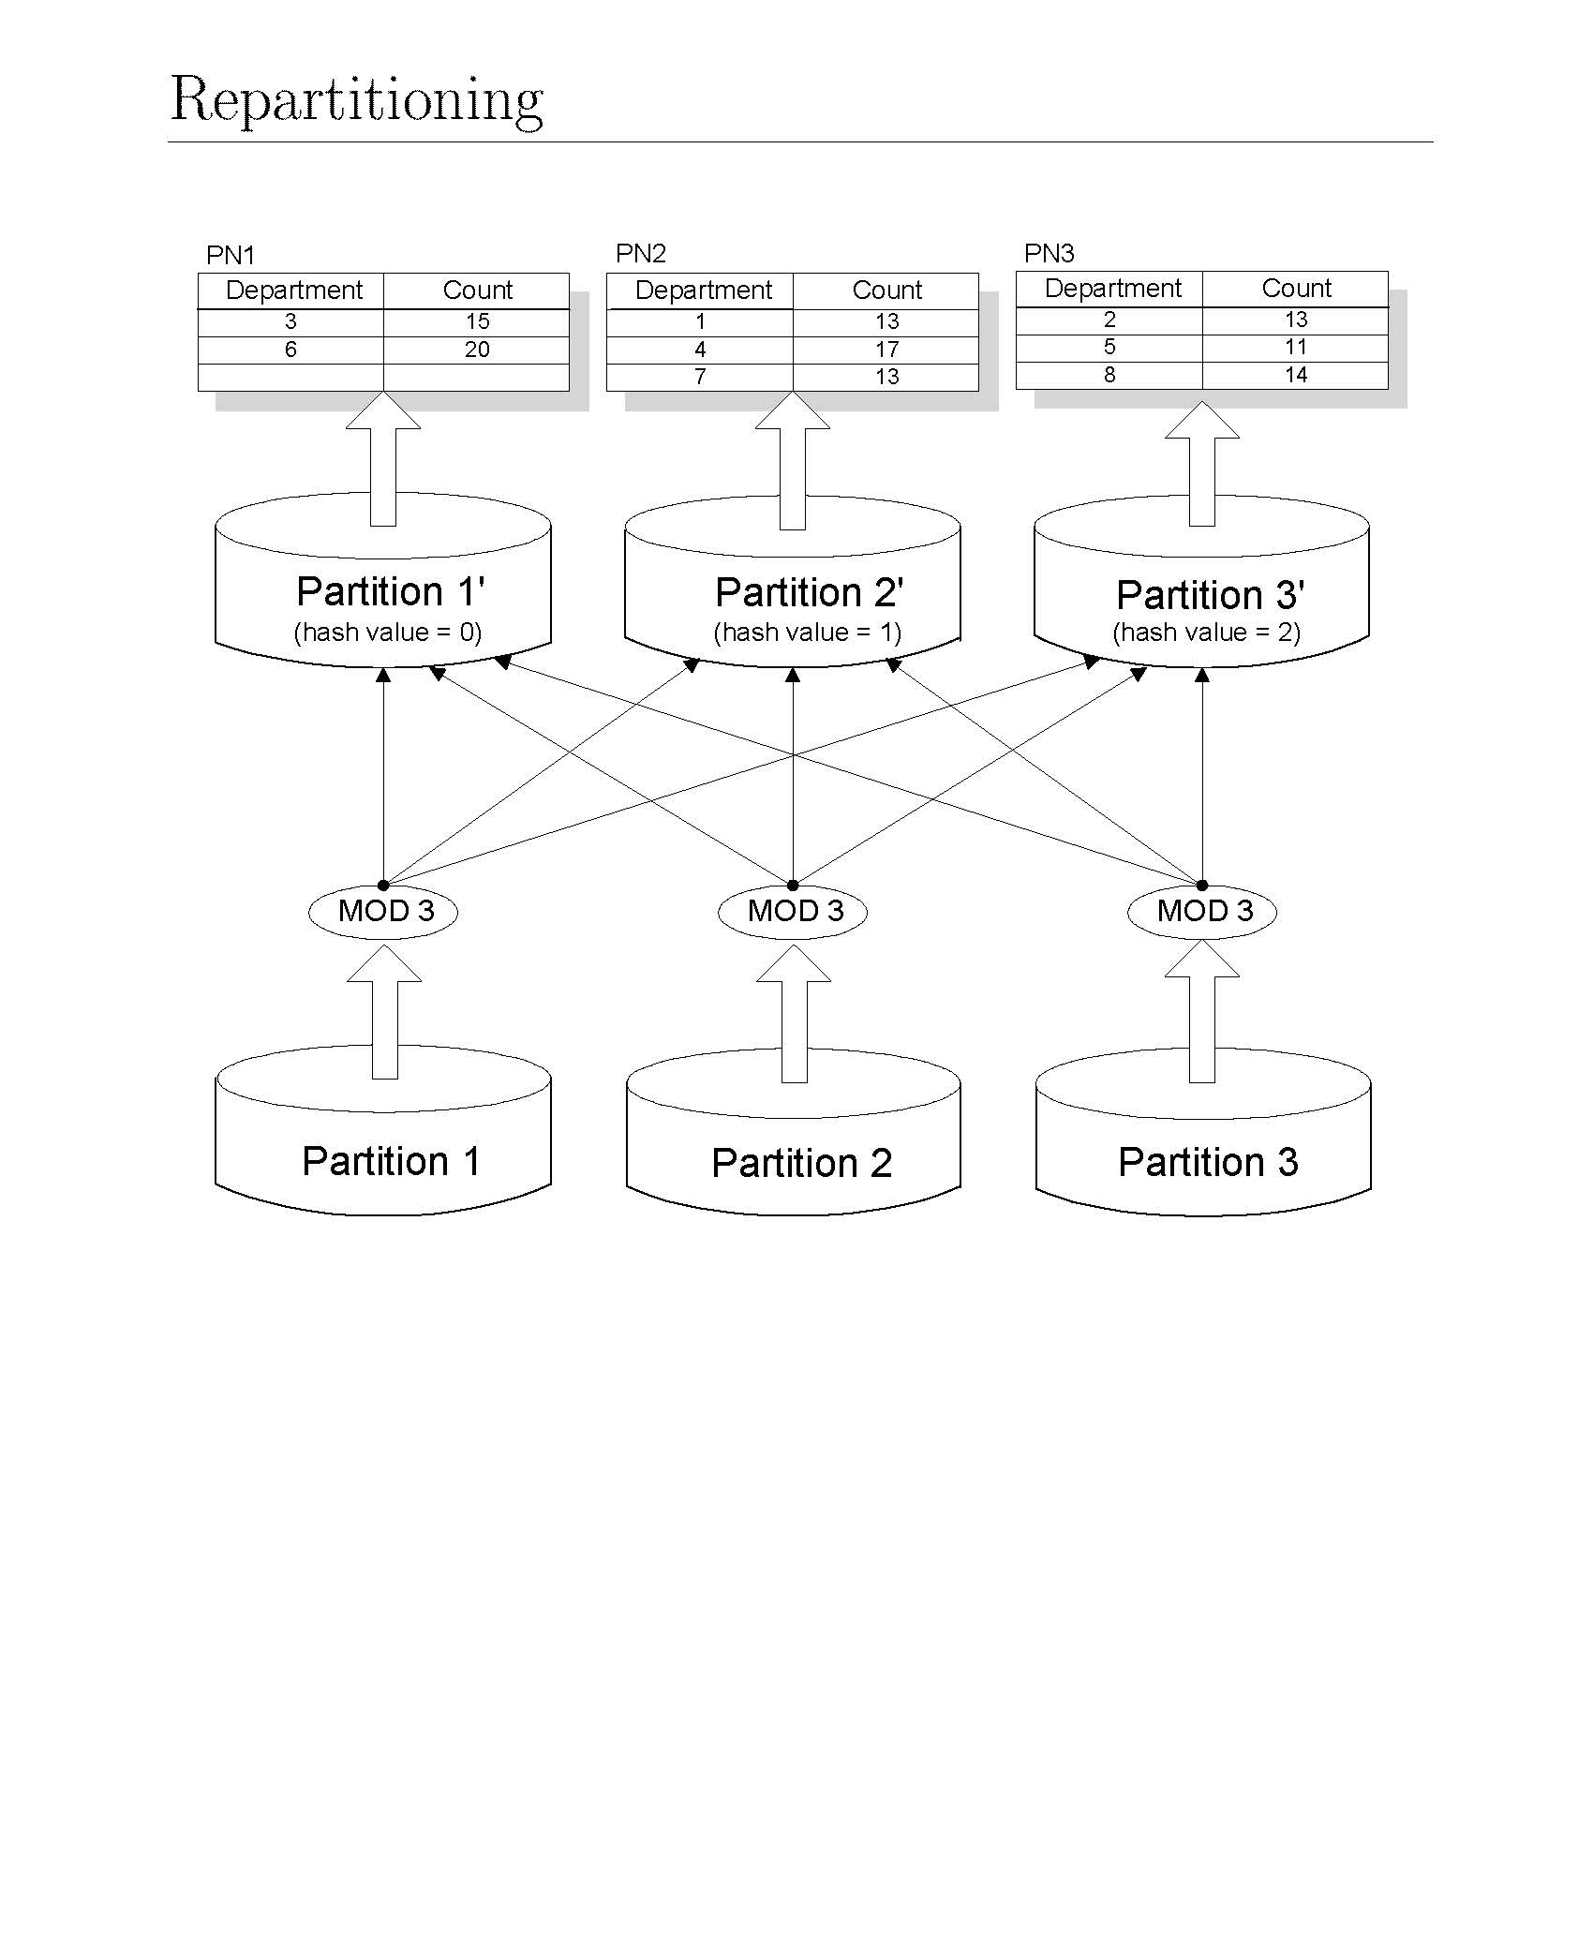
Notes:
Here we apply the hash function before processing.

Slide 96
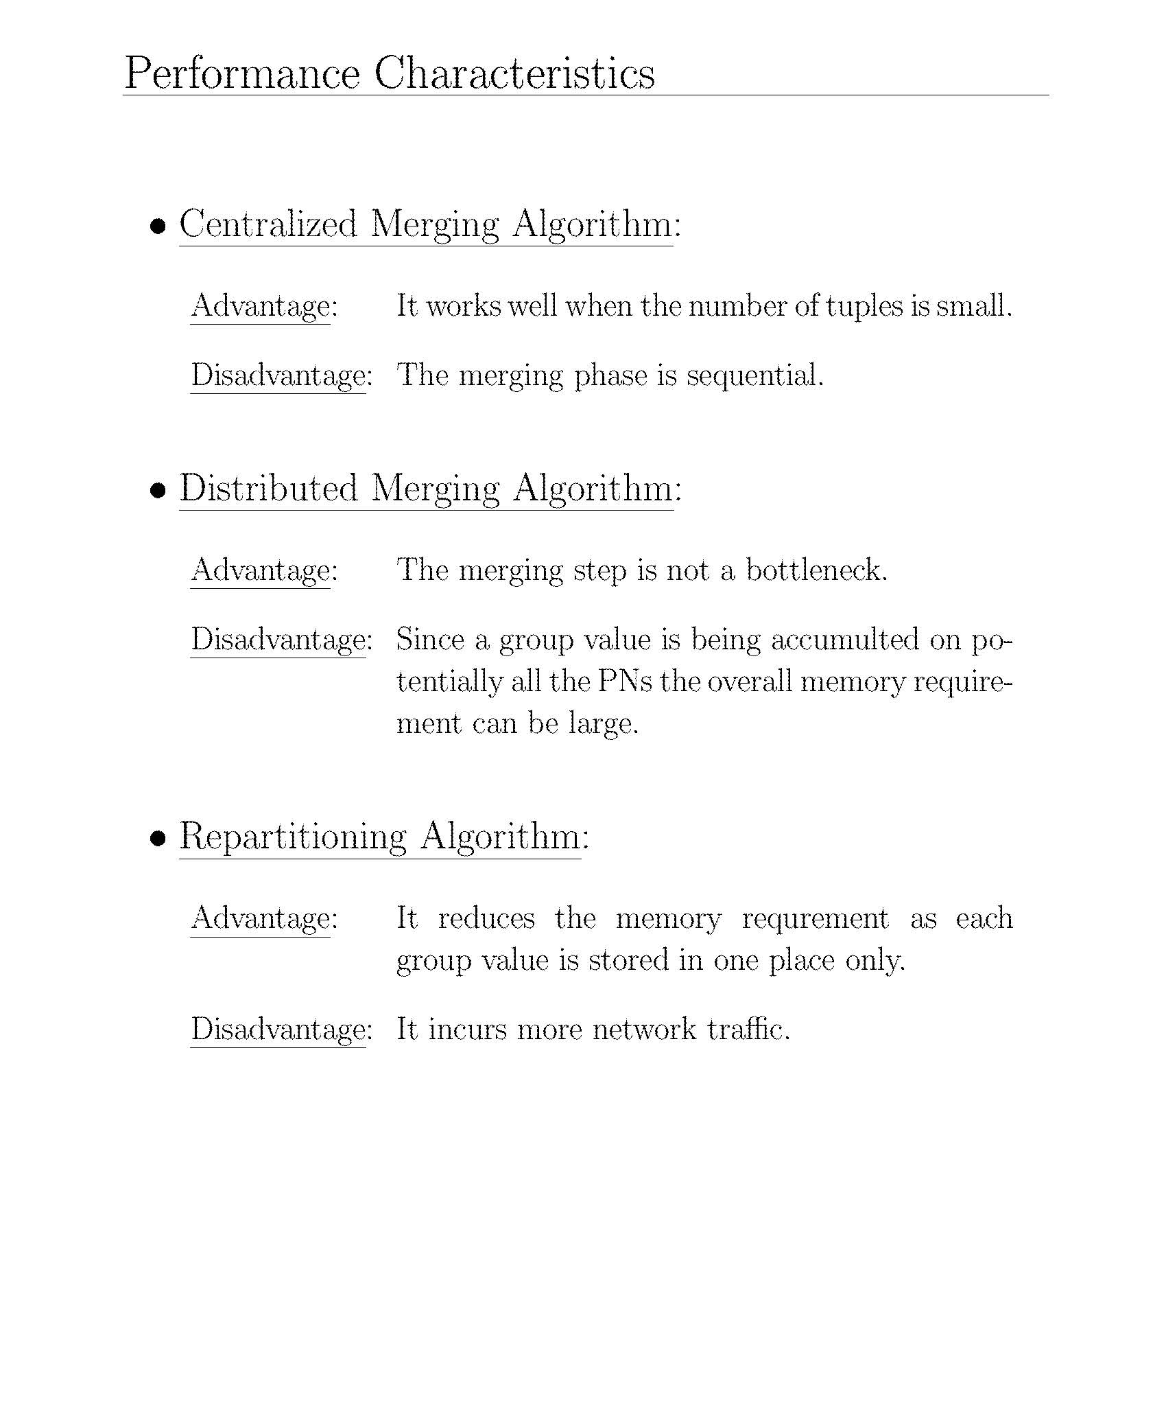

Slide 97
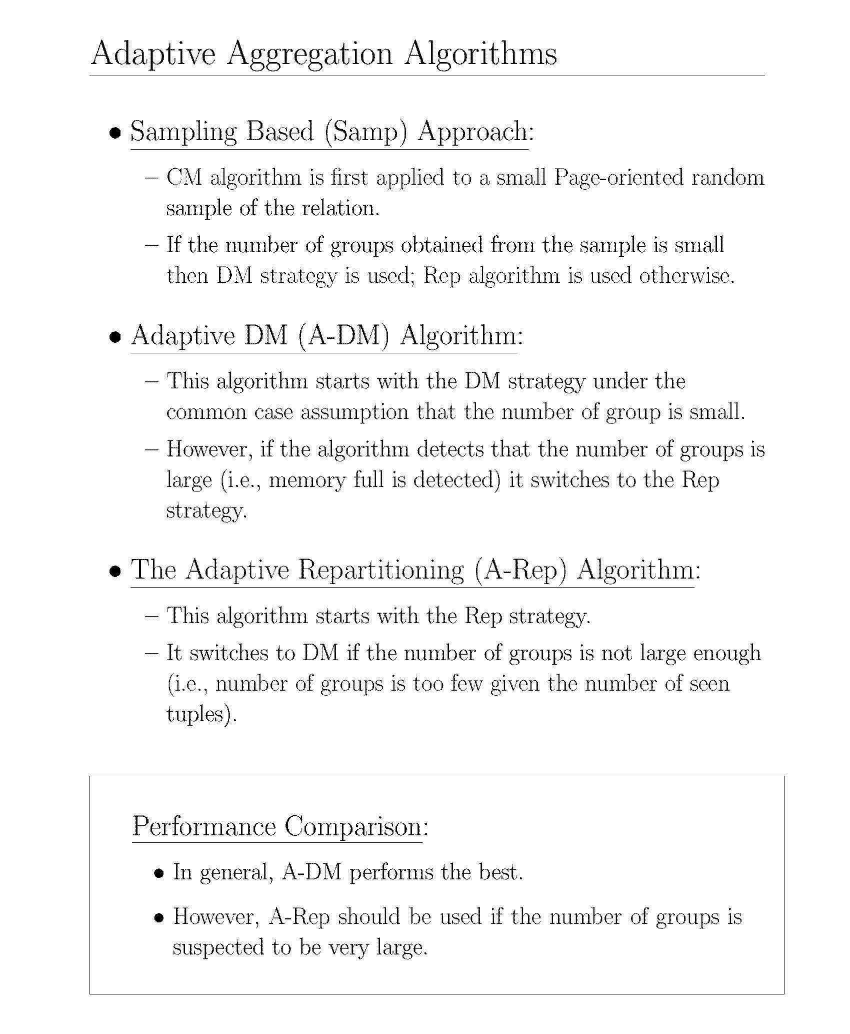
Notes:
The idea here is, how do we use CM or DM properly.

Slide 98
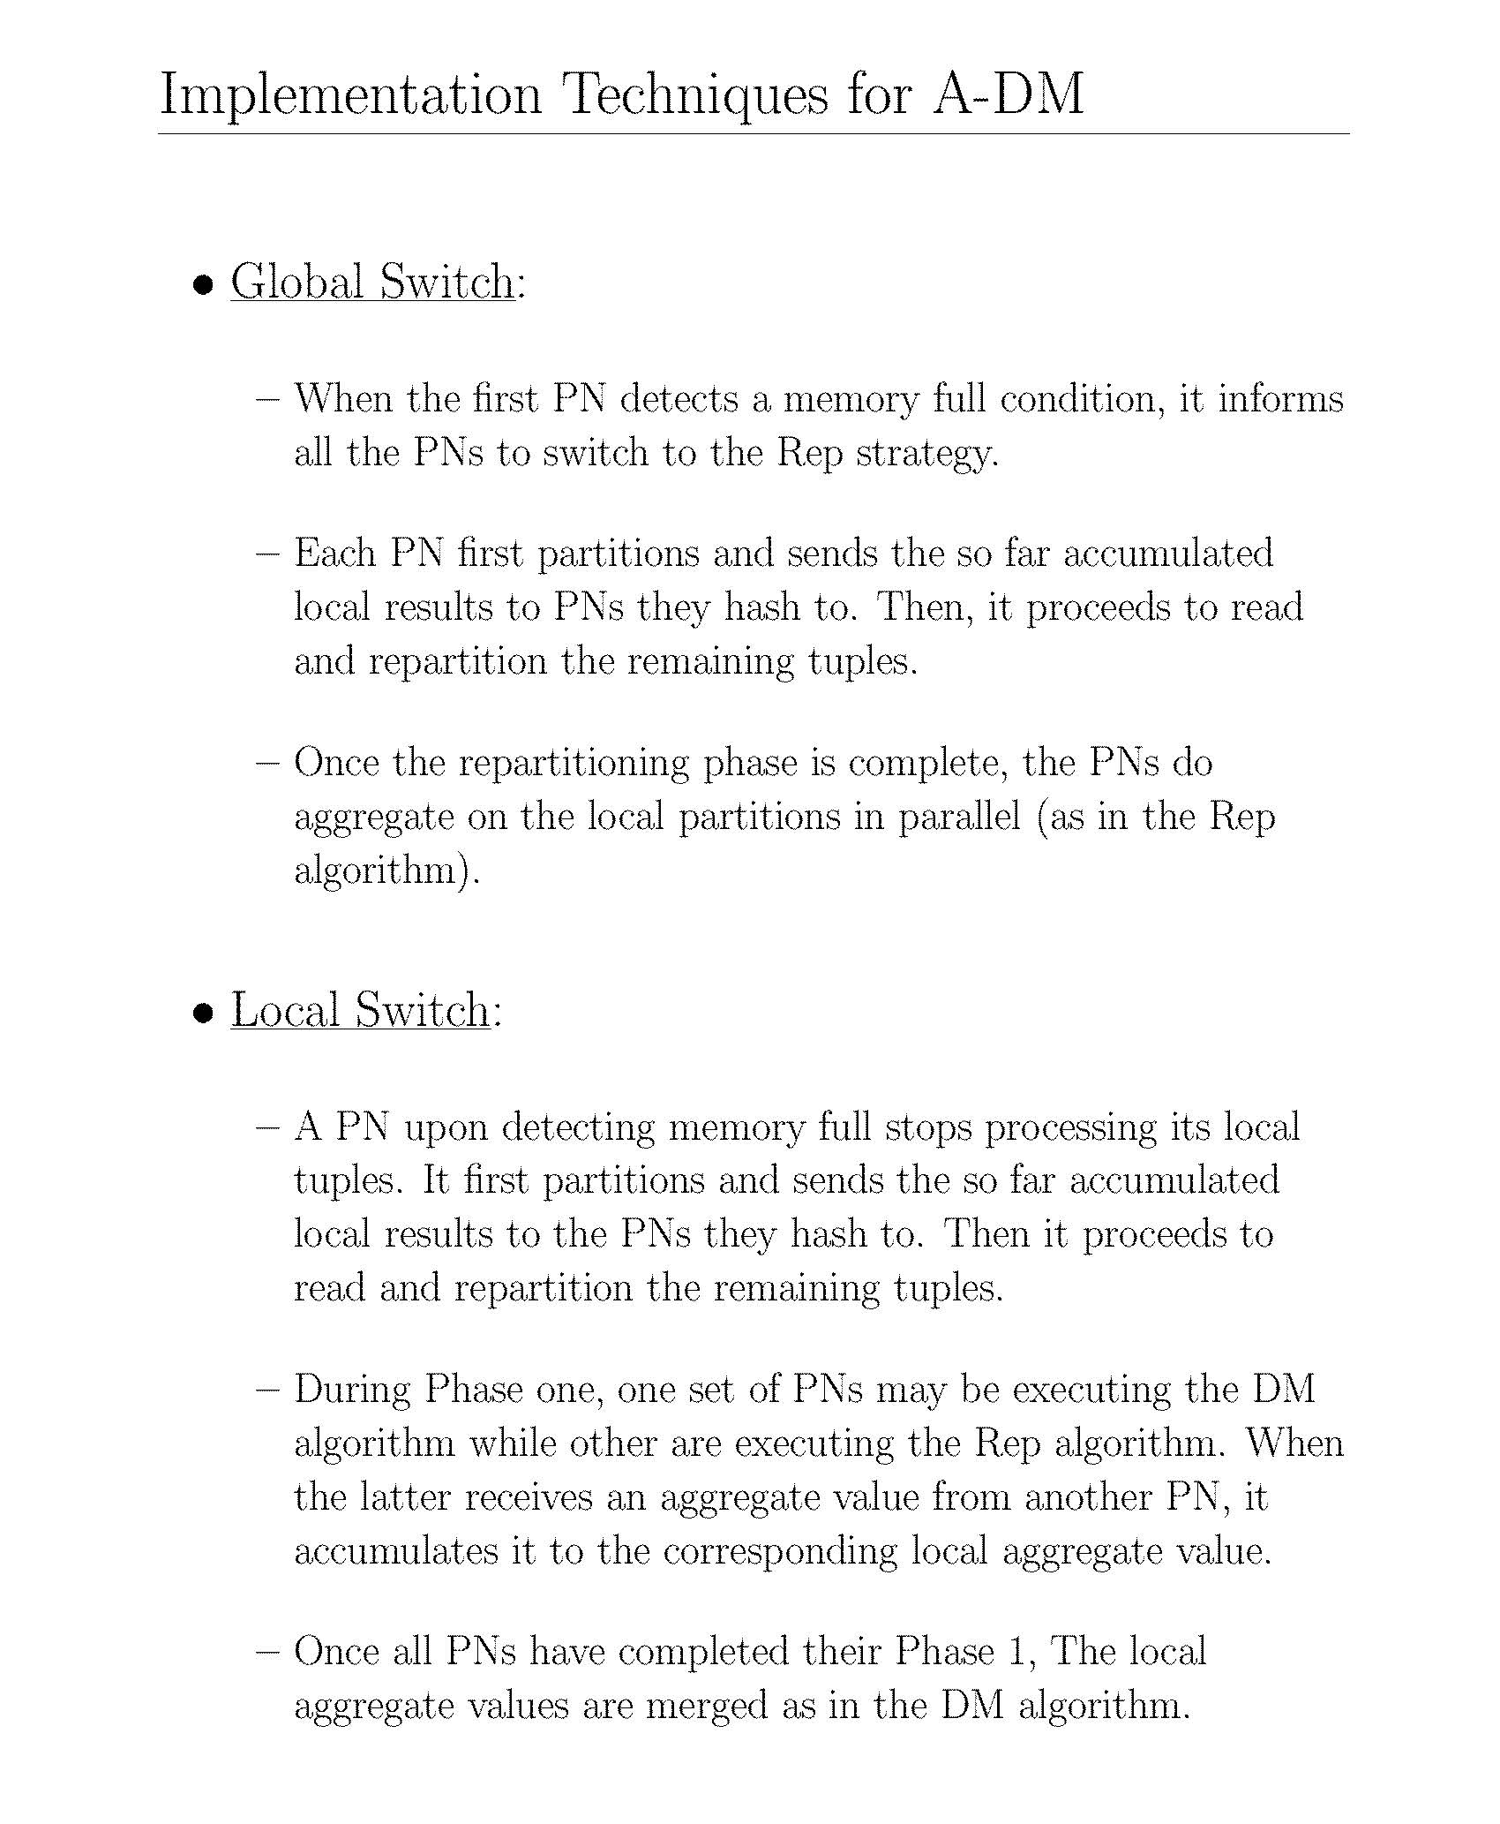
Notes:
Memory full means there is a lots of departments – so it is better to partition and switch

Slide 99
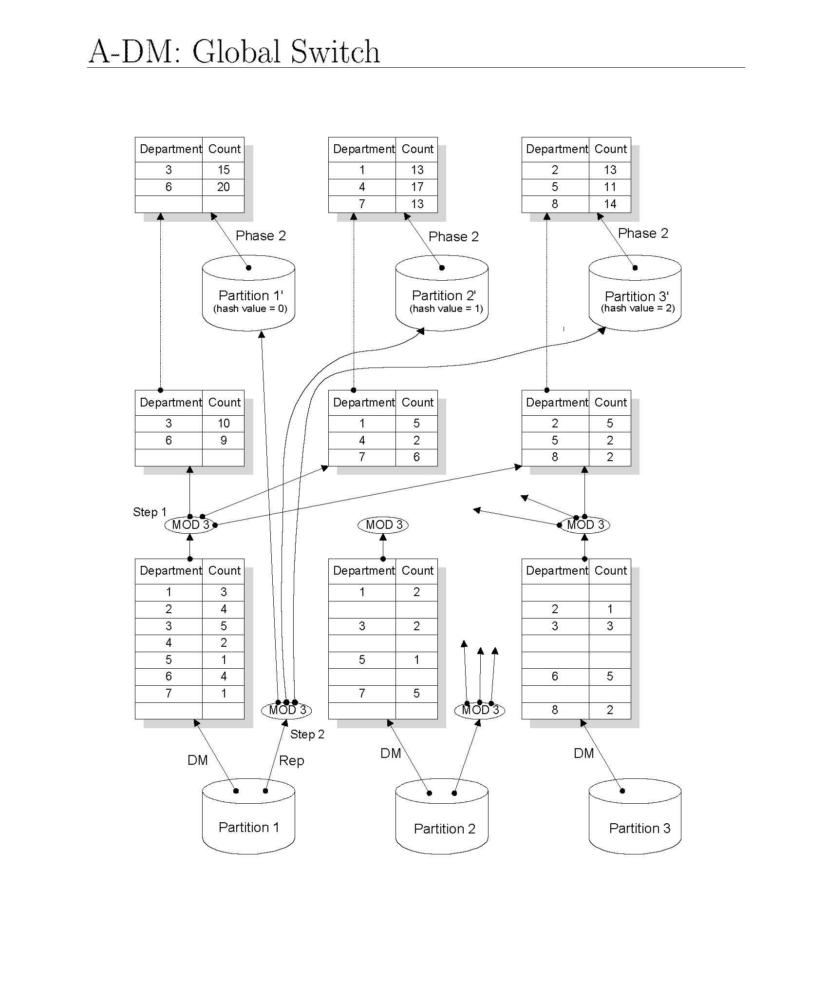
Notes:
Here all are partitioning
Switch to repartitiong and inform to other and other must follow

Slide 100
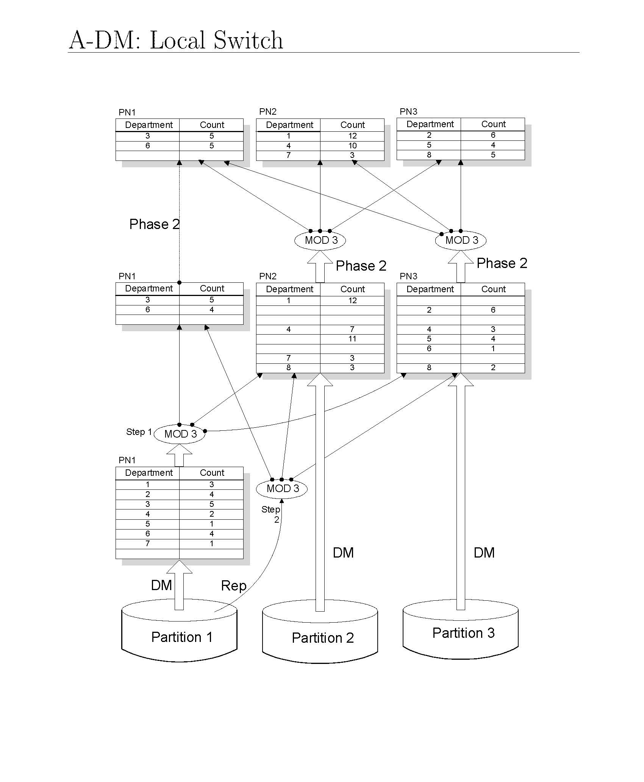
Notes:
Here only one is repartitioning.
Here partition 2 is not dependants on partition 1 result. It is local.
Sometimes local is a better idea than global.

Slide 101
Parallel Database Systems
Parallel DB Architecture
Parallel Data placement
Parallel Query processing
Load balancing
Database clusters

Slide 102
Database clusters
A database cluster is a cluster of autonomous databases, which is a combination of Parallel DB and data replication.
Much research has been devoted to take full advantage of the cluster environment (with fast, reliable communication) in order to improve performance and availability by exploiting data replication.

Slide 103
Database clusters
The main results of this research are new techniques for
replication,
load balancing,
query processing, and
fault-tolerance.
But, database cluster architecture, first.

Slide 104
SN cluster vs SD cluster
SN cluster can yield best cost/performance and extensibility
But adding or replacing cluster nodes requires disk and data reorganization
SD cluster avoids such reorganization but requires disks to be globally accessible by the cluster nodes
Network-attached storage (NAS)
distributed file system protocol such as NFS (Network File System), relatively slow and not appropriate for database management
Storage-area network (SAN)
Block-based protocol thus making it easier to manage cache consistency, efficient, but costlier
Notes:
SN (Shared Noting)
DAS(Direct Attached Storage) Architecture (Check in the internet) – Its too slow so no one Is using it.
SD (Shared Disk)

Slide 105
NAS vs SAN architecture
Clients
LAN
LAN
Database Servers
Win2k
Linux
Unix
Generic
Generic
Fibre Channel SAN
Application
Servers
Block Storage Devices
NAS Appliances
or
NAS Head Ends
Storage Area Network (SAN)

Slide 106
Database Cluster - Replication
As in distributed DBMSs, replication can be used to improve performance and availability.
The original replication protocol
Whenever a transaction Ti is to be triggered at some node i, node i multicasts Ti to all nodes 1, 2, …, n, including itself.
Once Ti is received at some other node j, it is placed in the pending queue in FIFO order.
Therefore, at each node i, there is a set of queues, q1, q2, …, qn, called pending queues.
Once a transaction is ordered, then the refresher writes it to the running queue in FIFO order, one after the other.
Finally the Deliverer keeps checking the top of the running queue to start transaction execution, one after the other, in the local DBMS.
Notes:
Ch 2 – Fragments – we need to distribute – sometimes we need to have multiple copies.
The idea is the same indifferent angle.

Slide 107
Database Cluster - Replication
The original replication protocol has two limitations.
First, it assumes that databases are fully replicated across all cluster nodes and thus propagates each transaction to each cluster node.
This makes the algorithm unsuitable for supporting very large databases.
The first limitation (fully replicated across all cluster nodes) can be addressed by providing support for partial replication
Second, it has performance limitations since transactions are performed one after the other, and must endure waiting delays before starting.
The second limitation is addressed by eliminating the delay time.

Slide 108
Database Cluster - Replication
The second limitation is addressed by eliminating the delay time.
Transactions are often naturally chronologically ordered with their timestamp.
The algorithm submits a transaction for execution as soon as it is received, thus avoiding the delay before submitting transactions.
When a transaction T is received out-of-order, all younger transactions must be aborted and re-submitted according to their correct timestamp order with respect to T.
Therefore, all transactions are committed in their timestamp order.
Notes:
The idea here is, if the PN1 has more capability then it can take many tasks. So it does not need to wait, and it can be done in parallel.
If the incorrect order is found then re-order.

Slide 109
Database Cluster – Load Balancing
In a database cluster, replication offers good load balancing opportunities, and the load balancing is easy to achieve.
Since all copies are mutually consistent, any node that stores a copy of the query data, e.g., the least loaded node, can be chosen at run-time by a conventional load balancing strategy.
Some approaches for load balancing in database clusters change the amount and type of workload submitted to the different replicas.
This approach is shown to provide high throughput, good scalability, and low response times for changing workloads with little overhead.
Notes:
Mutually consistent means all copies have same information. (If anyone tuple is updated then the other copies should also be updated)
Last 2 points – how we do? We discussed from slide 86.

Slide 110
Database Cluster – Query Processing
In a database cluster, parallel query processing can be used successfully to yield high performance.
Inter-query (and Intra-query) parallelism is naturally obtained as a result of load balancing and replication as discussed before.
Such parallelism is primarily useful
to increase the throughput of applications and
to reduce the response time of transactions and queries.
There are two alternative solutions for partitioning relations in a database cluster: physical and virtual.
Notes:
Inter and Intra query - Slide 14
Intra – Same operation, Inter – Different operations.
Throughput – Same amount of time, how much we can process
Response time: longest one
By apply parallel processing we can improve the throughtput and response time, but the assumption is all have the required data.

Slide 111
Database Cluster – Query Processing
Physical partitioning defines relation partitions, like horizontal fragments, and allocates them to cluster nodes, possibly with replication.
This resembles fragmentation and allocation design in distributed databases (see Chapter 2) except that the objective is to increase intra-query parallelism, not locality of reference.
Thus, depending on the query and relation sizes, the degree of partitioning should be much finer.
Under uniform data distribution, physical partitioning is shown to yield good intra-query parallelism and inter-query parallelism.
However, physical partitioning is static and thus very sensitive to data skew conditions and the variation of query patterns that may require periodic repartitioning.
Notes:
Locality of references: In chapter 2 it is a query point of view. If a site doesn’t need that data then we don’t need to give the data to that site.

Slide 112
Database Cluster – Query Processing
Virtual partitioning avoids the problems of static physical partitioning using a dynamic approach and full replication (each relation is replicated at each node).
In its simplest form, which we call simple virtual partitioning (SVP), virtual partitions are dynamically produced for each query
and intra-query parallelism is obtained by sending sub-queries to different virtual partitions.
Each DBMS that receives a sub-query is forced to process a different subset of data items.
Finally, the partitioned result needs to be combined by an aggregate query.
Notes:
Each query has a different partitioning. (Dynamic)

Slide 113
Database Cluster – Query Processing
SVP has some limitations. First, determining the best virtual partitioning attributes and value ranges can be difficult since assuming uniform value distribution is not realistic.
Second, some DBMSs perform full table scans instead of indexed access when retrieving tuples from large intervals of values.
Third, as a query cannot be externally modified while being executed, load balancing is difficult to achieve and depends on the initial partitioning.

Slide 114
Database Cluster – Query Processing
Fine-grained virtual partitioning addresses these limitations by using a large number of sub-queries instead of one per DBMS.
Working with smaller sub-queries avoids full table scans and makes query processing less vulnerable.
However, this approach must estimate the partition sizes, and query processing time using database statistics. In practice, these estimates are hard to obtain.

Slide 115
Database Cluster – Query Processing
Adaptive virtual partitioning (AVP) solves this problem by dynamically tuning partition sizes, thus without requiring these estimates.
AVP runs independently at each participating cluster node, avoiding inter-node communication (for partition size determination).
Initially, each node receives an interval of values to work with. These intervals are determined exactly as for SVP.
Notes:
Apply fine grain to each node because each node have different sizes.

Slide 116
Database Cluster – Query Processing
Then, each node performs the following steps:
Start with a very small partition size beginning with the first value of the received interval.
Execute a sub-query with this interval.
Increase the partition size and execute the corresponding sub-query
Stop increasing if a stable size has been found.
If there is performance degradation, i.e., there were consecutive worse executions, decrease size and go to Step 2.

Slide 117
Database Cluster – Query Processing
AVP has several advantages:
flexibility for node allocation,
high availability because of full replication, and
opportunities for dynamic load balancing.
But full replication can lead to high cost in disk usage.
To support partial replication, hybrid solutions have been proposed to combine physical and virtual partitioning.
Notes:
To support partial replication we use a hybrid (physical and virtual combine)

Slide 118
Database Cluster – Query Processing
The hybrid design uses physical partitioning for the largest and most important relations and fully replicates the small tables.
Thus, intra-query parallelism can be achieved with lesser disk space requirements.
The hybrid solution combines AVP with physical partitioning.
It solves the problem of disk usage while keeping the advantages of AVP.

Slide 119
Database Cluster – Fault-tolerance
There are several issues raised by failures.
The first is how to maintain consistency despite failures.
Second, for outstanding transactions, there is the issue of how to perform failover (recovery).
Third, when a failed replica is reintroduced (following recovery), the current state of the database needs to be updated.
The main concern is how to cope with failures. To start with, failures need to be detected.
In group communication based approaches, failure detection is provided by the underlying group communication.
Notes:
ACID properties should be satisfied.
Durability – RAID is used to maintain durability.
An outstanding transaction means an important transaction.

Slide 120
Database Cluster – Fault-tolerance
Failures should also be detected at the client side.
Clients typically connect through TCP/IP, and can suspect of failed nodes via broken connections.
Upon a replica failure, the client API must discover a new replica, reestablish a new connection to it, and, in the simplest case, retransmit the last outstanding transaction to the just connected replica.
Since retransmissions are needed, duplicate transactions might be delivered. This requires a duplicate transaction detection and removal mechanism.

Slide 121
Main Products
Vendor | Product | Architecture | Platforms
IBM | DB2 Pure Scale DB2 Database Partitioning Feature (DPF) | SD SN | AIX on SP Linux on cluster
Microsoft | SQL Server SQL Server 2008 R2 Parallel Data Warehouse | SD SN | Windows on SMP and cluster
Oracle | Real Application Cluster Exadata Database Machine | SD | Windows, Unix, Linux on SMP and cluster
NCR | Teradata | SN Bynet network | NCR Unix and Windows
Oracle | MySQL | SN | Linux Cluster

Slide 122
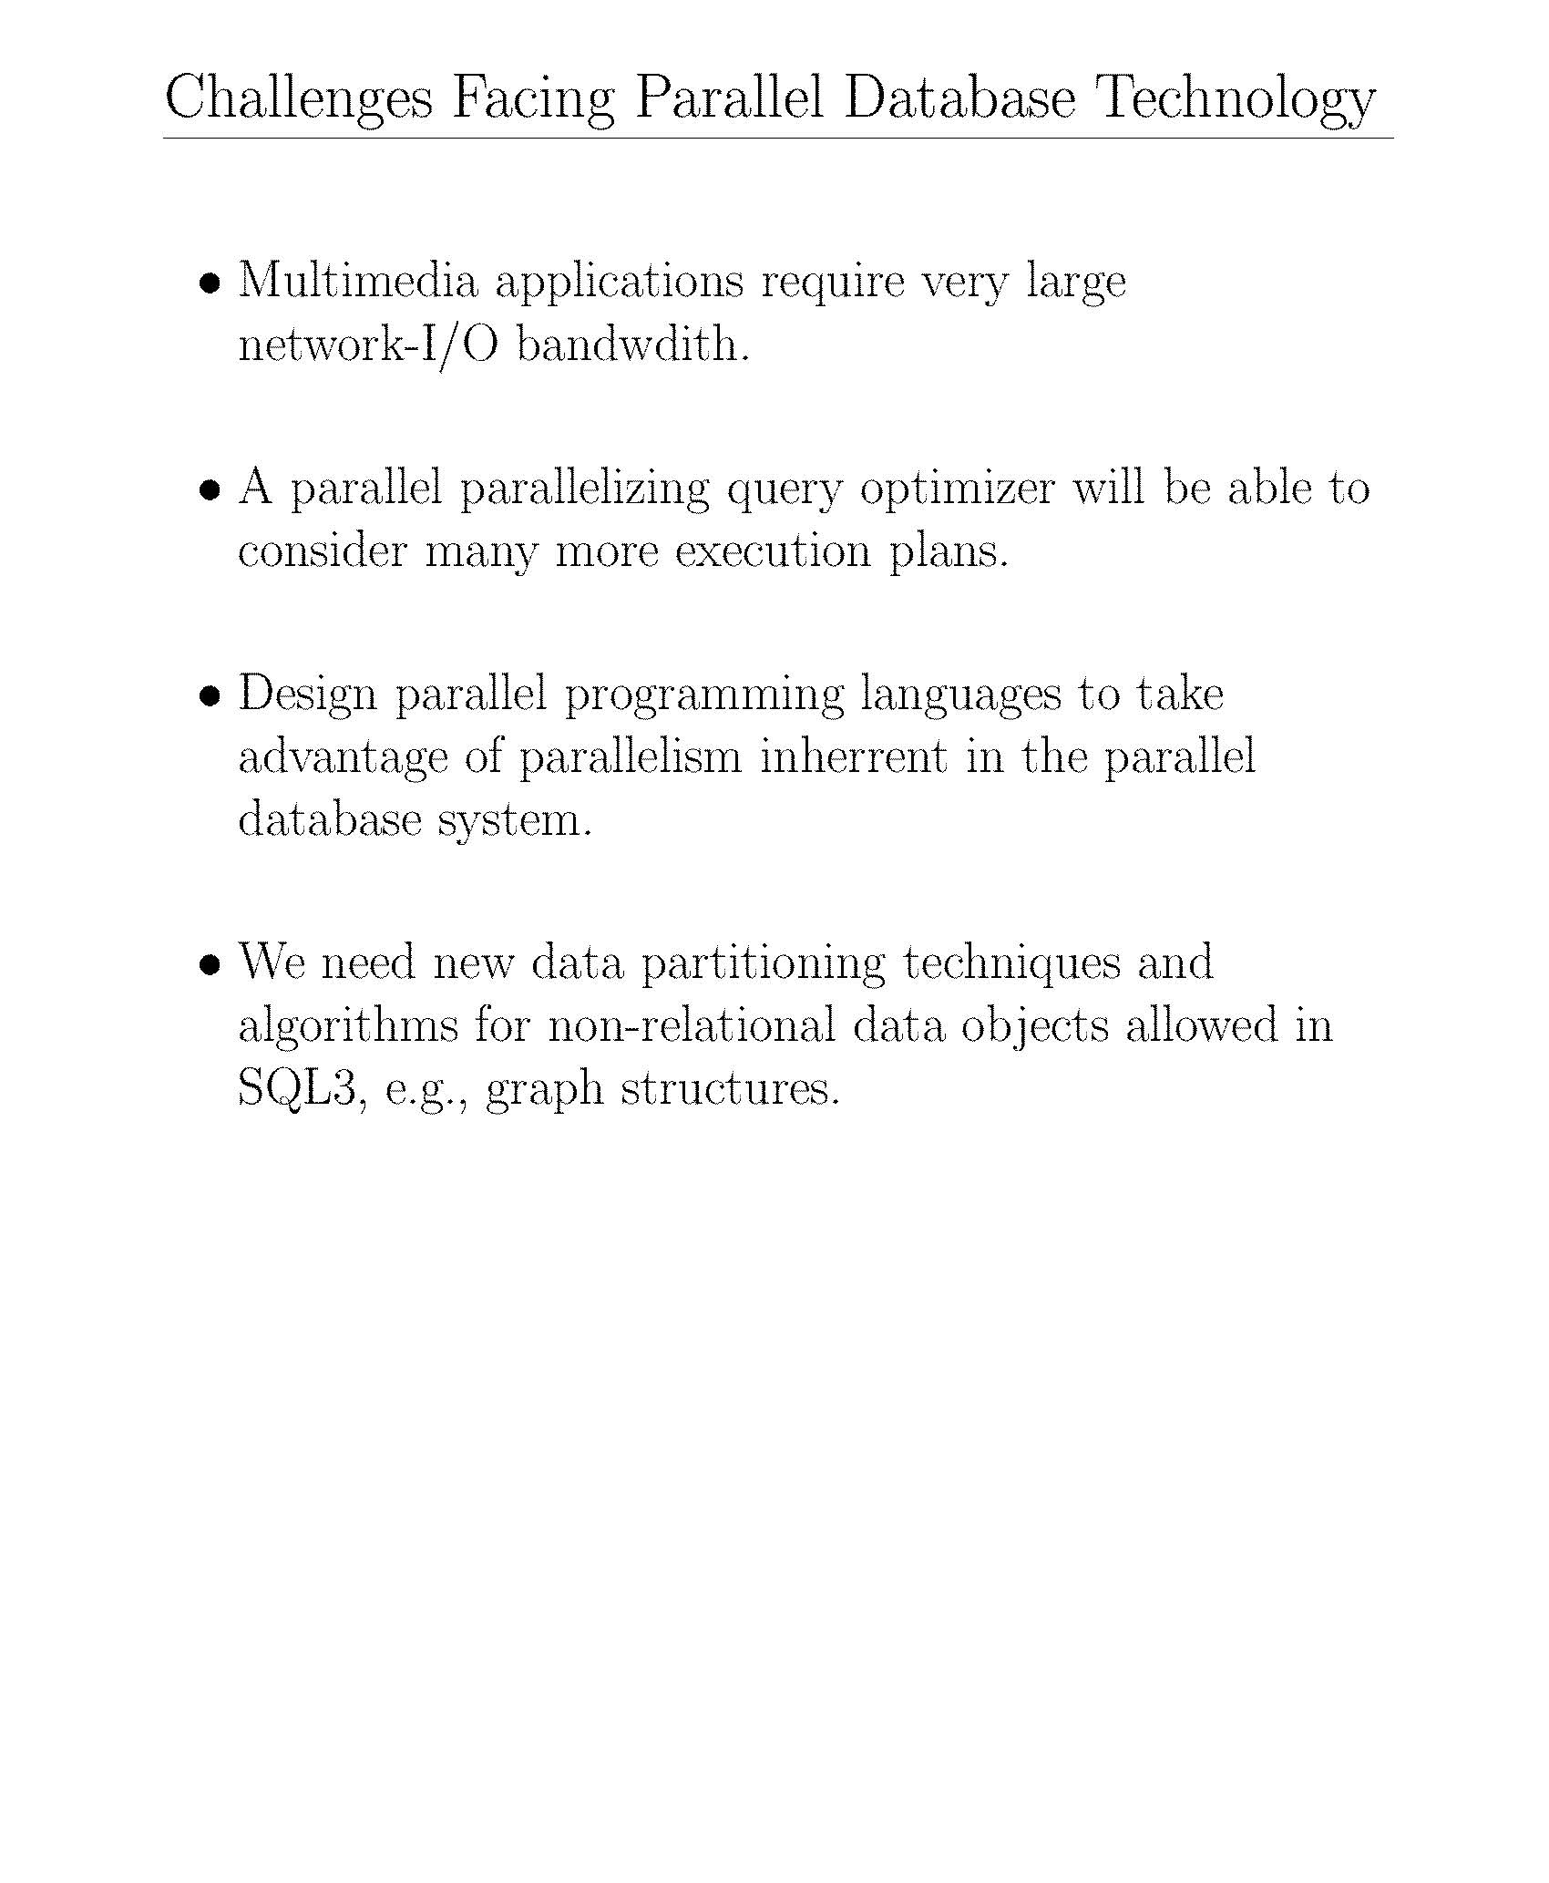
Notes:
Multimedia: Photos and videos.

Slide 123
